Slide 1
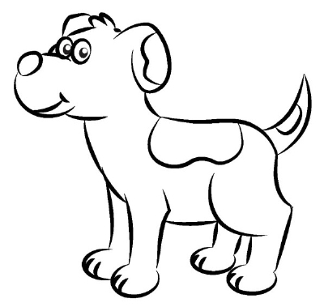
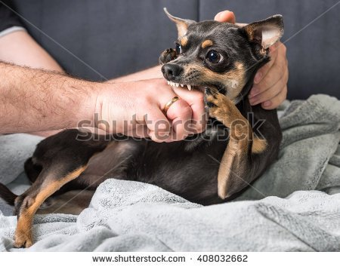
ADJECTIVES MAKE EVERYTHING MORE INTRESTING
FEROUCIOUS,
TICK INFESTED,
DROOLING,
DOG
DOG

Slide 2
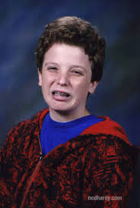
In middle school you called them describing words. It’s time to grow up.

Slide 3
In high school we call them modifiers.

Slide 4
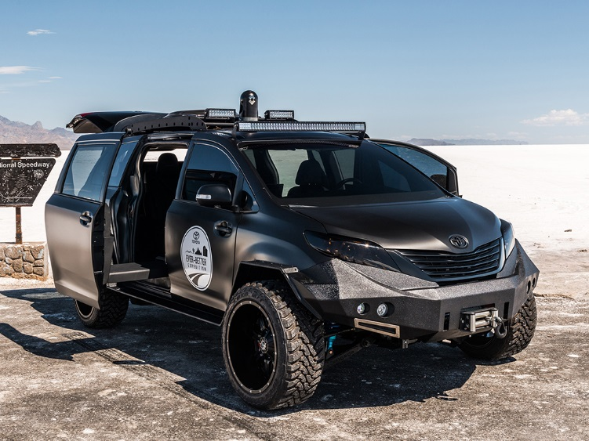
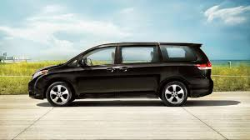
IF I MODIFIED MY CAR IT WOULD GO FROM THIS

Slide 5
2 KEY IDEAS TO FINDING ADJECTIVES

Slide 6
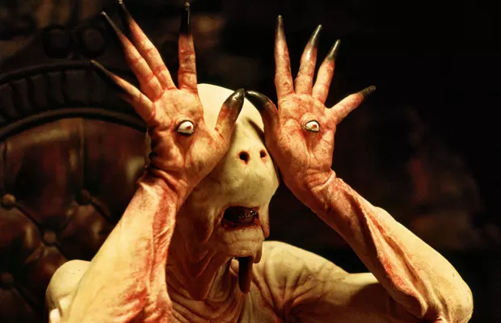
ADJECTIVES ADD TO NOUNS
1.
ONE,
TERRIFYING, SICKENING,
MONSTER
MONSTER

Slide 7
ADJECTIVES ANSWER:
2.
What Kind?
Silent offspring
Creepy siblings
How Many?
Numerous horrors
Thirty vermin
How Much?
Many minions
Few underlings
Which Ones?
That beast
Those creatures

Slide 8
1. Find the Noun 2.Does it answer: Which Kind, How Many, How Much or Which Ones

Slide 9
The orange monster dripped red blood.
1. Find the nouns
2. What kind
Orange Red

Slide 10
Odysseus was gone for ten years?
1. Find the nouns
2. How many?
Ten

Slide 11
Many goddesses seduced Odysseus.
1. Find the nouns
2. How much/many
many

Slide 12
He left that island to go home.
1. Find the nouns
2. Which Ones?
that

Slide 13
But wait, that’s not all!
There are three types of adjectives
Proper, Compound and Articles

Slide 14
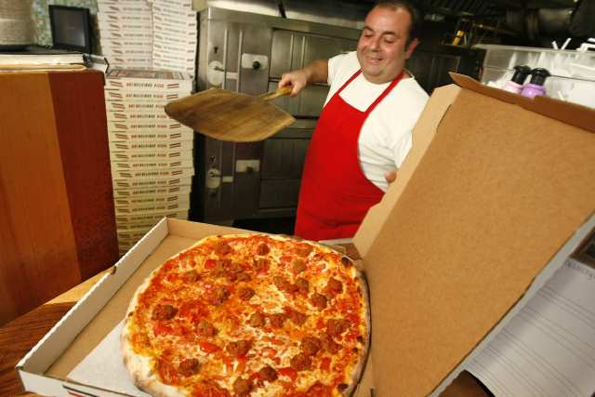
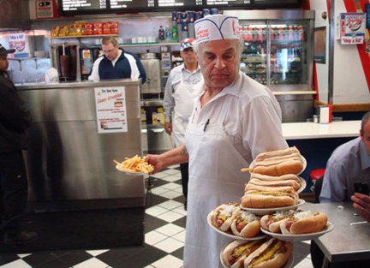
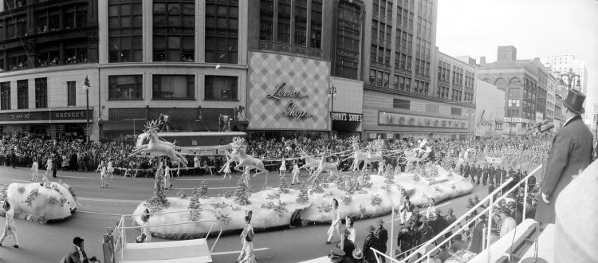
Proper Adjectives
THEY’RE CAPITALIZED
New York pizza
Detroit Coney dogs
Thanksgiving parade

Slide 15
Compound Adjectives
Still modifies but now it is two or more words
household chore
record-breaking year
faraway land

Slide 16
Articles
A
An
The

Slide 17
Proper, compound or article
I love North Carolina BBQ.
PROPER
NOUN

Slide 18
Proper, compound or article
The lions are winning?
Article
NOUN

Slide 19
Proper, compound or article
Ireland is my motherland.
Compound
NOUN

Slide 20
Which word is an adjective?
Do you like scary movies?
SCARY
Which word is modifying the noun?
NOUN
NOUN
What word answers:
What kind?
How many?
How Much
Which ones?

Slide 21
AGAIN
NOUN
NOUN
The silent class starred at the teacher.
THE (2)
Which word is modifying the noun?
SILENT
What word answers:
What kind?
How many?
How Much
Which ones?

Slide 22
AGAIN
Few seats in the classroom were full.
FEW
THE
NOUN
NOUN
full

Slide 23
NOUN
NOUN
The lifeless class took mediocre notes with dull pencils.
THE
LIFELESS
MEDICORE
NOUN
DULL

Slide 24
12 students are failing this quarter.
12
NOUN
NOUN
THIS

Slide 25
The Thanksgiving turkey was a record-breaking bird.
NOUN
THANKGIVING
RECORD-BREAKING
NOUN
THE
A

