Slide 1
ADVERBS
MODIFIES VERBS, ADJECTIVES AND OTHER ADVERBS

Slide 2
ENDS IN LY, RIGHT
YES BUT THERE’S MORE
Definitely, absolutely, dangerously…
Not and its contraction n’t
ARE ALWAYS adverbs

Slide 3
List is on page 546

Slide 4
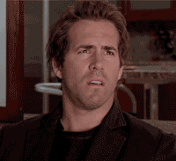
But the list wont always help
Knowing how they behave will

Slide 5
Find your verb
He looked everywhere for help.
“Looked” is the verb
EVERYWHERE
Is there any additional about the verb?
Remember Adverbs are MODIFIERS
MODIFIERS ADD information

Slide 6
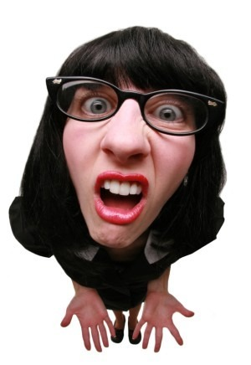
Wait, there’s more
Adverbs can also modify adjectives

Slide 7
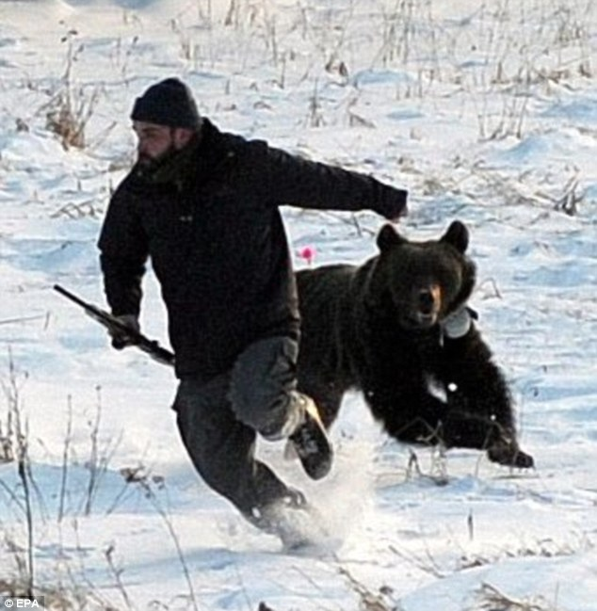
Try these steps
Find the adjectives (remember they modify nouns)
Is there any additional information added to them?
Visiting national parks is always fun.

Slide 8
Adverb or Adjective
She had a warm smile and lively eyes.
I especially loved her silly grin.
I especially loved her silly grin.
It was easy for us to fall asleep.
Sometimes we swam in the lake.

Slide 9
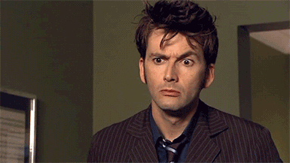
Here’s the last bit you need to know
Adverbs also can add to other adverbs

Slide 10
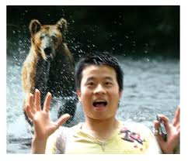
Try these steps
Find the adverbs in a sentence (remember they add to verbs and/or adjectives)
Is there any additional information about them?
Visiting national parks is almost always fun.

Slide 11
Finding Adverbs isn’t hard they just modify more
Look for the “ly”
Look for “not” or “n’t”
Find your verbs
Are they being modified
Find your adjectives
Are they being modified
Find your adverbs
Are they being modified

Slide 12
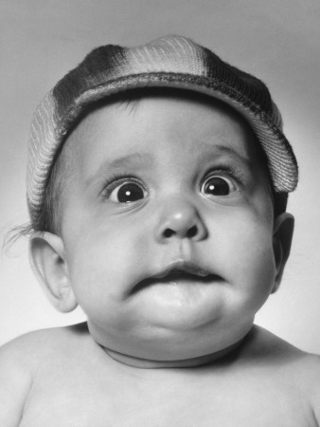
Let’s pull the sentences apart and find our adverbs

Slide 13
Try it
Find VERBS, ADJECTIVES, ADVERBS
Porcupines never shoot their quills.
My very early memories are filled with visits up north.
The drive through the park can be rather long.
I sometimes sleep in a tent.
East House is continually full of students.
My sister completely enjoys the experience.

Slide 14
For the test
Identify adverbs in a sentence
Know what the adverb is modifying
Identify between and adverb and an adjective

Slide 15
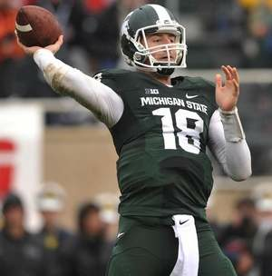
Identify the adverb
Connor Cook threw the football quite well.
The extremely talented football team won.
We visit Spartan Stadium yearly.
My friends and I joyfully roamed the campus in East Lansing.
We knew the campus very well.

Slide 16
Adverb or Adjective
We visit my Aunt Sylvia yearly.
Our yearly visits to Aunt Sylvia are filled with fun.
ADVERB
ADJECTIVE

Slide 17
What is the adverb modifying?
We would cheer loudly through Spartan Stadium.
Tired out after a game, the players would go to bed early.
Sometimes we sang the fight song.
I especially loved leaving after a win.
It was super easy for us to win.
Everyone carefully drove home after the game.

