Slide 1
Annotation
It’s a verbal doodle

Slide 2
For this class
Character Analysis
Connections
Big Questions
Significant Quotes, phrases, word choice

Slide 3
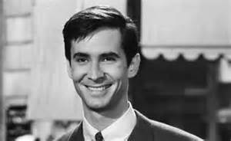
Character Analysis
What do you initially see?

Slide 4
Character Analysis
What do they say?
Mother wouldn’t like that.

Slide 5
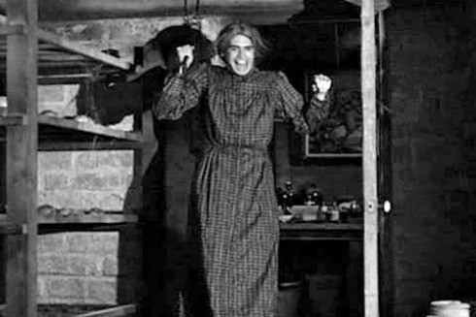
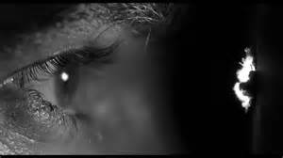
Character Analysis
How do they behave?

Slide 6
Connections
He reminds me of that creepy Uncle (your life)
Don’t most serial killers live alone (the world)
OMG this is that movie my parents keep talking about (other media)
Is he a cross dresser (random?)

Slide 7
Big Questions
Where’s his mother? Even if she’s dead what caused him to go this bad? (the unknown of a character)
Why do serial killers look so normal? (connect character to humanity)
Why focus so closely on his eyes? Is there some deeper meaning in the eyes? (Theme?)

Slide 8
Significant Quotes
Character | Evidence | Conclusions
Norman | Mother won't like this | His mother is the reason for his psychosis
Norman | A boy’s best friend is his mother | Ironic His mother drove him to this
Norman | We all go a little mad sometimes. | A judgment about society?

