Slide 1
Appositives It’s all about nouns baby
Is it:
Noun or Pronoun
Does it:
Identify/explain another noun or pronoun

Slide 2
My captain, Odysseus didn’t listen to me.
During our journey we met a
Cyclops, Polyphemus.

Slide 3
Appositives usually come RIGHT AFTER what ever it modifies
My captain, Odysseus didn’t listen to me
During our journey we met a
Cyclops, Polyphemus.

Slide 4
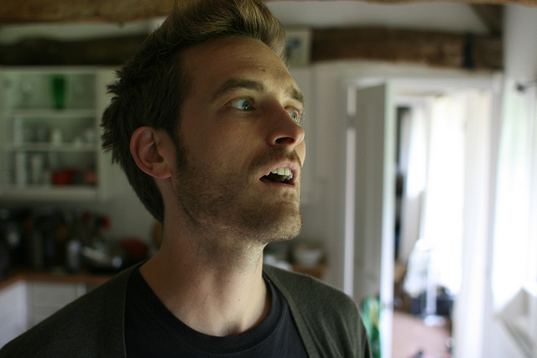
If you add that all together you have an APPOSITIVE PHRASE.

Slide 5
My captain, Odysseus didn’t listen to me.
APPOSITIVE PHRASE
During our journey we met a Cyclops, Polyphemus.

Slide 6
Try it
The dude, Kyle, that lived in the land of the Lotus flower had issues.
Find the nouns/pronouns
The dude,Kyle, that lived in the land of the Lotus flower had issues.
Do you have a noun followed by a noun?
Does it Identify or Explain the other noun?

Slide 7
Try it
The Lotus flower, a very potent drug, seemed like a good idea at the time.
Find the nouns/pronouns
Do you have a noun followed by a noun?
Does it Identify or Explain the other noun?
What’s your appositive ? drug
What’s your appositive phrase? The Lotus flower, a very potent drug.

Slide 8
Last one
10 years seemed like a day on her island, Harsen.
Find the nouns/pronouns
Do you have a noun followed by a noun?
Does it Identify or Explain the other noun?

