Slide 1
Capitalization
Wait that’s not capitalized correctly, is it?

Slide 2
Capitalization
There that’s better.

Slide 3
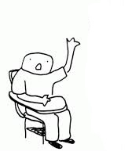
Excuse me, I already know this.

Slide 4
The basics
Great! Let’s review quickly.
Fine.
I not i
First words of sentences

Slide 5
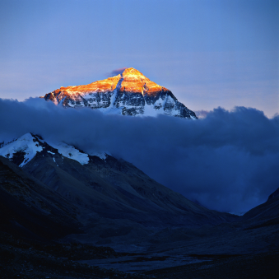
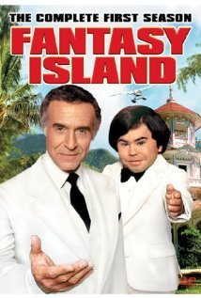
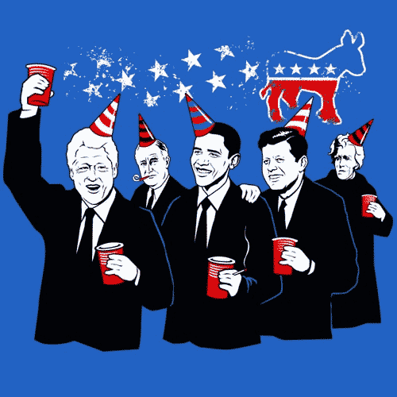
Names
the Fray
Band names
People’s names
Bridges names
Bob Smith
Judasim
Pluto
Religious names
Stars names
Mount Everest
Narwhal
Mountains names
Animal’s names
Names of holidays
Arbor Day
Islands names
Towns names
Counties names
Fantasy Island
Paris, Texas
Streets names
Hoover Road
Names of Teams
Historical names
Detroit Tigers
Cities names
Really?
The Elizabethan Period
States names
Names of groups
Class names
The Democrats
Planets names

Slide 6
So you capitalize proper names of things and people and places.
That’s still pretty easy.

Slide 7
Watch out for exceptions
Twenty-two Mile Road
Streets- second part of a hyphenated numbered street IS NOT capitalized.
States are capitalized but the word is not
Sections of the country are but compass directions are not
Institutions are but only if they are proper
Names of specific classes are but not general classes
The state of Michigan.
In the Midwest you drive north.
Cousino High School is a high school.
The english class I am taking is Honors English.

Slide 8
And this weird one
When writing time AM and PM are capitalized
Except if you write them like this
a.m. and p.m.

Slide 9
A few rules you might not know
Proper Adjectives- when a proper noun is describing something.
Proper Noun
Detroit
Irish
Proper Adjective
Detroit pride
Irish eyes are smiling

Slide 10
Titles Like a book
Exception
Of a book
Short stories
Poems
Newspapers
Articles
Magazines
TV shows
But don’t capitalize
Conjunctions- and, but, so, or prepositions –over, under, by…
or articles – the , a an
unless the title starts with it.

Slide 11
Titles -not like a book -somebody’s title
General
Queen
President
Doctor
General Miller
Queen Jenny
President Stanczyk
Doctor Phil
Capitalize before a name
Capitalize when the title is used alone
Inform the General I will be shooting.
Jenny is the Queen of Detroit.
I will not challenge the President.
Exception
Not after a name
Mr. Miller is a general.
Jenny is a queen
Mrs. Stanczyk does not want to be president
Phil is not my doctor.

Slide 12
When in doubt capitalize but know the exceptions

