Slide 1
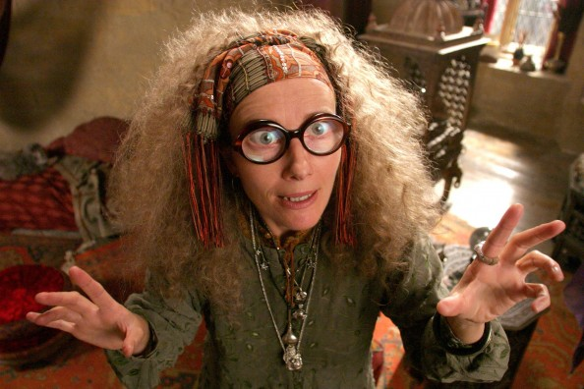
How to write a complete sentence.

Slide 2
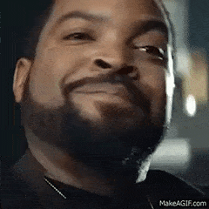
What do I have to have in a sentence?
It has to be a complete thought.
You need a subject and a predicate.
That’s three things:
a complete thought
a subject
a predicate.

Slide 3
A sentence needs
a complete thought
a subject
a predicate.
GO TO PAGE 579 in Grammar book
Do Practice Your Skills 1-8
Check with neighbor

Slide 5
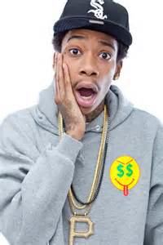
What’s a subject?
It’s the noun the sentence is about.
Wiz lost his phone in the toilet.

Slide 6
A Subject is the noun the sentence is about.
Page 581 PYS 1-10

Slide 8
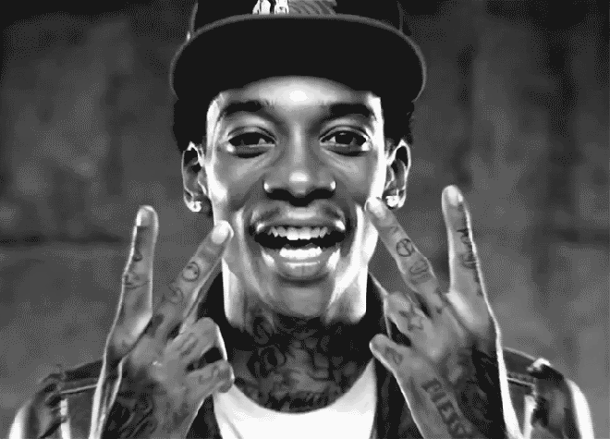
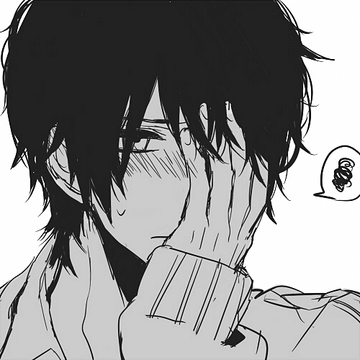
What is a predicate?
It’s a verb. ☺
It’s what the subject is doing.
Remember verbs don’t just show action but they do always give your subject something to do.

Slide 9
A predicate, a verb, is what the subject is doing.
Verbs show action and/or give the subject something to do.

Slide 10
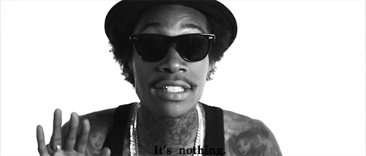
So where is the predicate?
Remember it’s what your subject, Wiz, is doing.
Wiz lost his phone in the toilet.

Slide 11
Beware the linking/ helping verb
They are verbs and they are predicates!
Is
Are
Was
Can
Will
Wiz and Iggy are pretty smooth.

Slide 12
Linking verbs are verbs and can be predicates.
Go to Page 582
Write down Common Linking Verbs, at the bottom of the page, in your notes

Slide 14
If a sentence doesn’t have: a subject a predicate and a complete thought it’s a fragment.
The weird girl in the hallway
The weird girl isn’t doing anything so she has no predicate and that sentence is a fragment.

Slide 15
Subject? Predicate? Complete Thought?
My mother called me yesterday.
Your mother.
Mothers are the reason you are here.
My mom can.
Who’s your mamma?
When I was young me and my mama had beef.

Slide 16
That was easy!
That was review!
Notes:
End week 1

Slide 17
Complete subjects
Includes all the words used to identify the subject, basically everything before the predicate.
Complete Subject
A young Iggy Azaela looked differently than she does now.
Notes:
Simple subject is Iggy Azaela complete is a young Izzy Azaela

Slide 18
Try it
Find the predicate- what was done?
Complete subject!
The future rapper looked just like you.
Ask- whom or what is the sentence about?

Slide 19
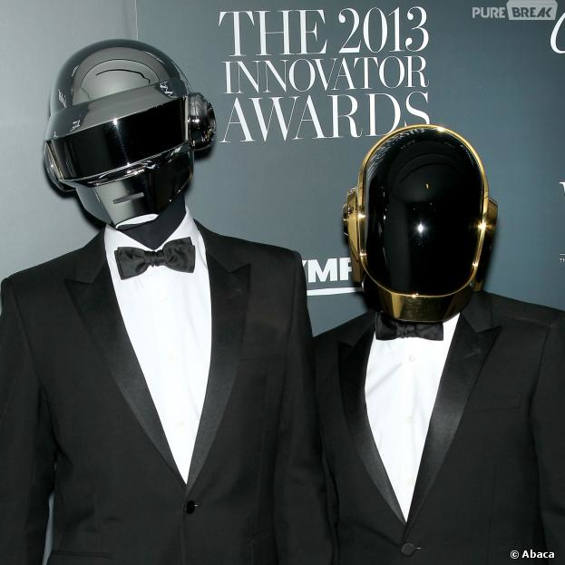
Here’s another
Find the predicate- what was done?
Ask- whom or what is the sentence about?
Complete subject!
The 2014 Emmy award for innovation went to Daft Punk.

Slide 20
To find the complete subject draw line before the predicate, everything before that is the complete subject.
Go to Page 580
Do Practice Your Skills
Write the whole sentence
Draw line before predicate.
Mark the complete subject
1-10

Slide 22
Complete predicate
Find the subject-ask- What is the subject doing?
Includes all the words that tell what the subject is doing, basically everything including the predicate to the end of the sentence.

Slide 23
Try it
Find the predicate- what was done?
Complete Predicate
A young Iggy Azaela looked differently than she does now.

Slide 24
Find the predicate- what was done?
Complete Predicate
The 2014 Emmy award for innovation went to Daft Punk.

Slide 25
To find the complete predicate draw line before the predicate, everything after that is the complete predicate.
Go to Page 583
Do Practice Your Skills
Write the whole sentence
Draw line before predicate.
Mark the complete subject
1-10

Slide 27
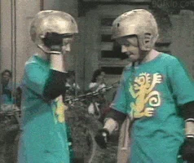
Compound Subjects
Compound subject: Two or more subjects connected with the same verb connected with a conjunction.

Slide 28
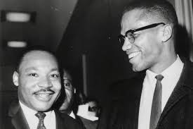
Compound subject
Martin and Malcolm fought for the rights of African American people.
Find the predicate- what was done?

Slide 29
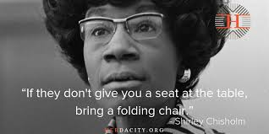
Shirley Chisolm and Mary Bethune were early activists in the civil rights movements.
Compound subject

Slide 30
Compound subject is 2 or more subjects that have the same verb and are joined by a conjunction.
Go to Page 587
Do Practice Your Skills
Write the compound subjects
1-10

Slide 32
Compound Predicate
Compound Predicate: Two or more verbs with the same subject connected by a conjunction.

Slide 33
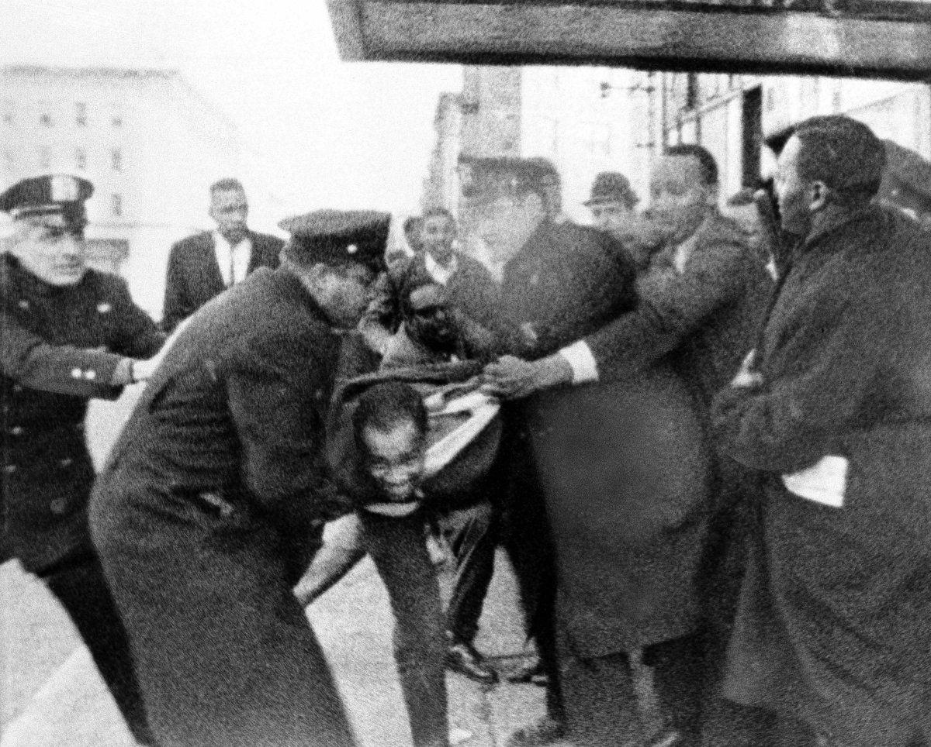
Malcolm X resisted arrest and was beaten.
Find the first predicate look to the right
for a conjunction(and) find the next verb.

Slide 34
Compound predicate is 2 or more verbs that have the same subject and are joined by a conjunction.
Go to Page 588
Do Practice Your Skills
Write the compound verbs
1-10

