Slide 1
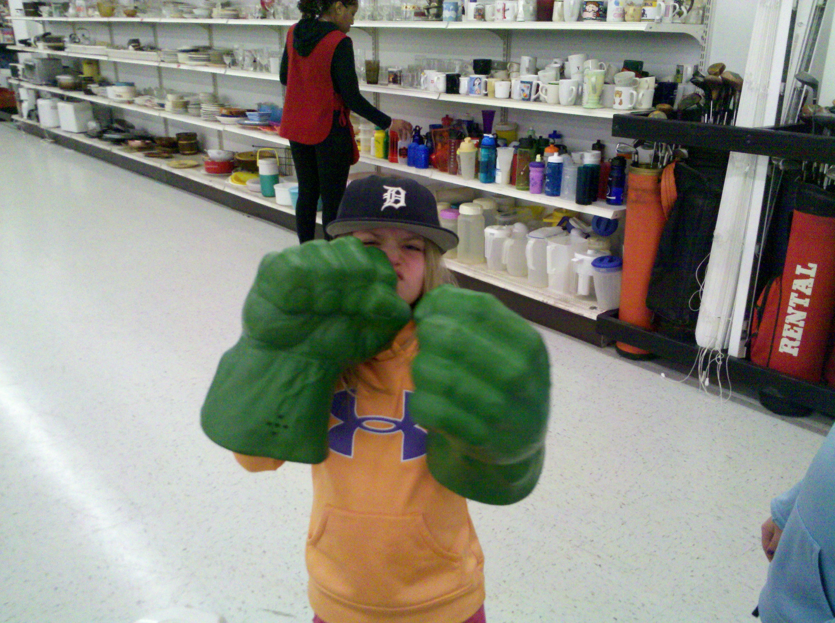


CLASSROOM PROCEDURES

Slide 2
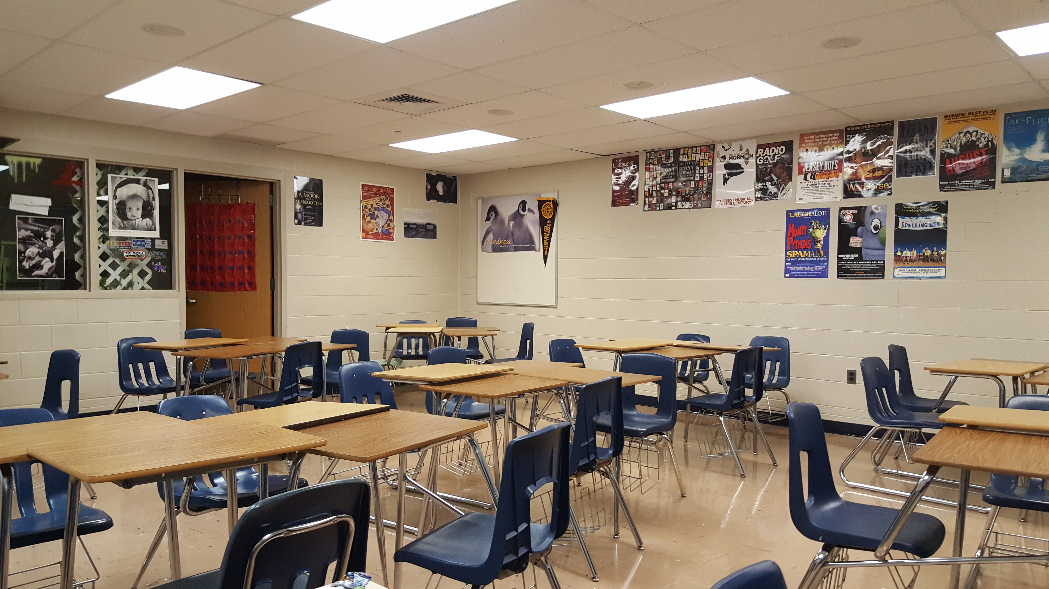
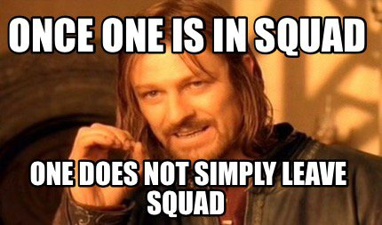
CLASSROOM PROCEDURES
SEATING CHART CHANGES EVERY MONTH.
DO NOT FEEL FREE TO MOVE AROUND, IF YOU DO SO YOU WILL LOSE POINTS.
Seats

Slide 3
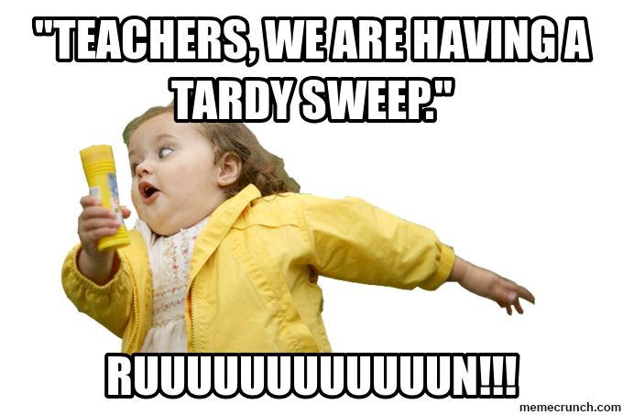

CLASSROOM PROCEDURES
ONCE I HAVE TAKEN ATTENDANCE YOU ARE LATE.
AFTER 10 MINUTES YOU ARE CONSIDERED UNEXCUSED & ABSENT.
Tardies
Notes:
First hour tardy slips

Slide 4
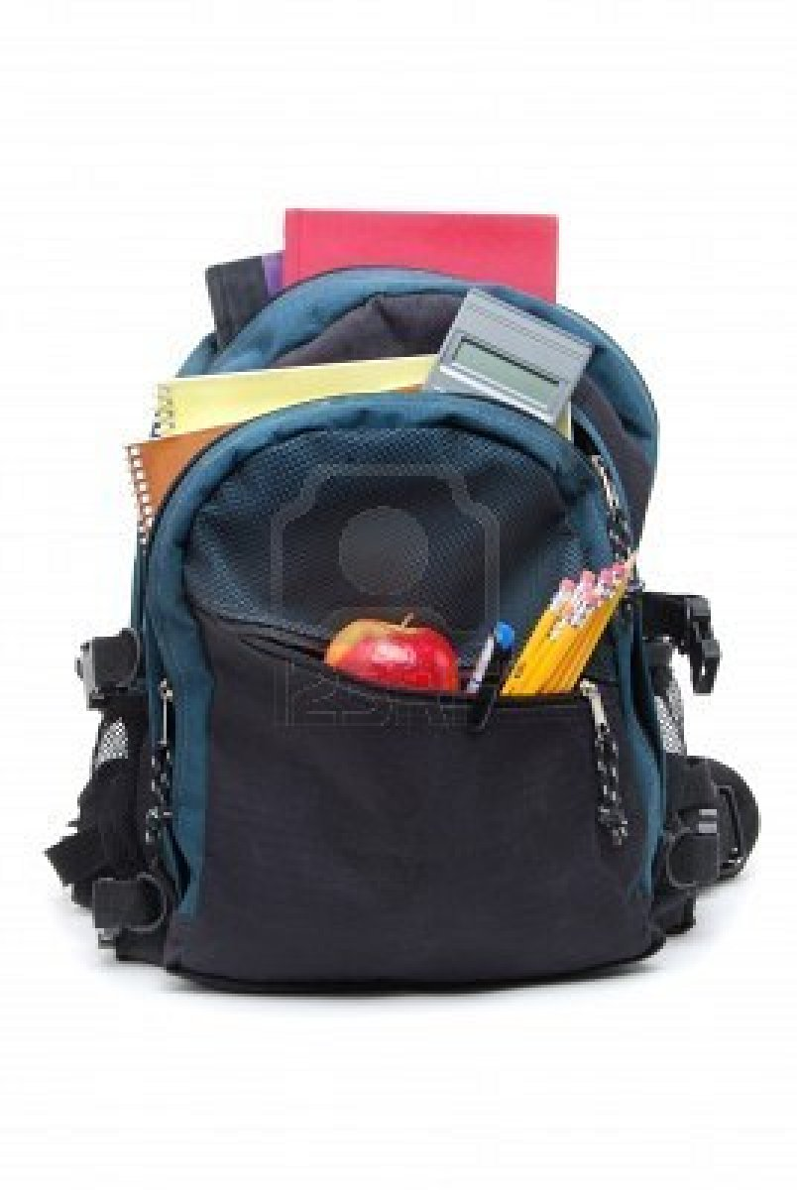

CLASSROOM PROCEDURES
YOU ARE RESPONSIBLE
FOR :
PEN
PAPER
BOOKS
NOT YOUR CLASSMATES!
Supplies

Slide 5
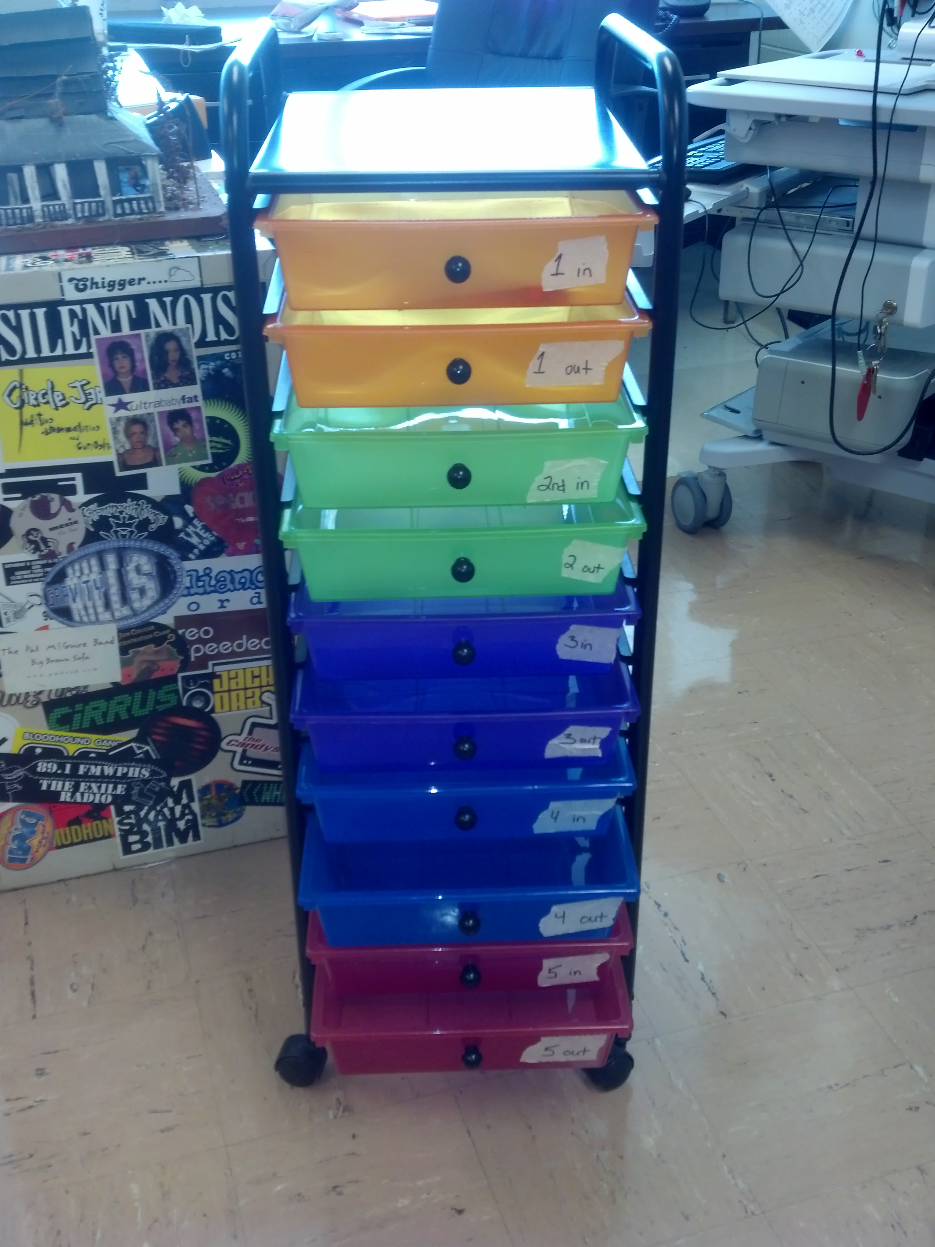
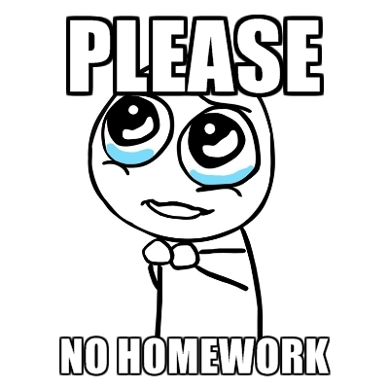
CLASSROOM PROCEDURES
USE THE HOMEWORK CART.
EACH HOUR HAS AN ASSIGNED COLOR.
Homework

Slide 6
CLASSROOM PROCEDURES
HOMEWORK GOES IN AT THE START OF CLASS.
Homework
TOP DRAWER
TO BE GRADED.
BOTTOM DRAWER IS GRADED.

Slide 7
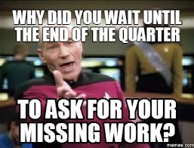
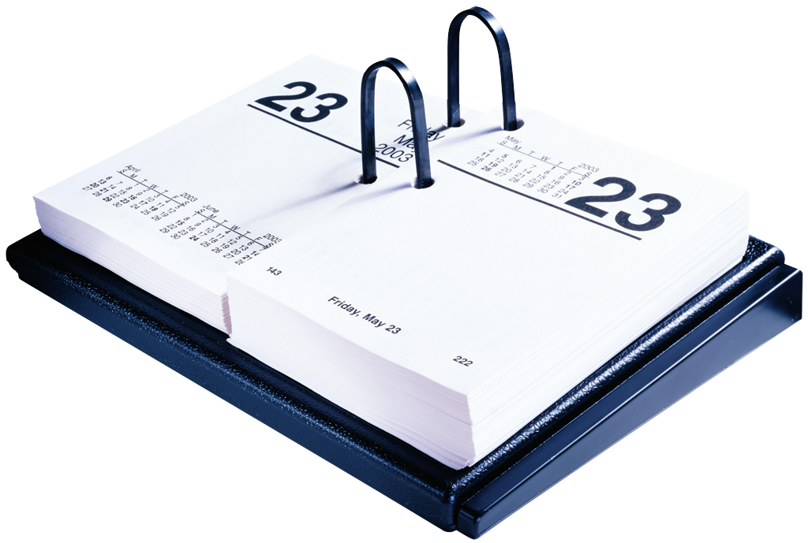
CLASSROOM PROCEDURES
YOU HAVE THE SAME AMOUNT OF EXCUSED DAYS YOU MISSED, TO MAKEUP WORK.
WRITE ABSENT ON TOP OF YOUR WORK.
Homework
Notes:
25% of grade

Slide 8
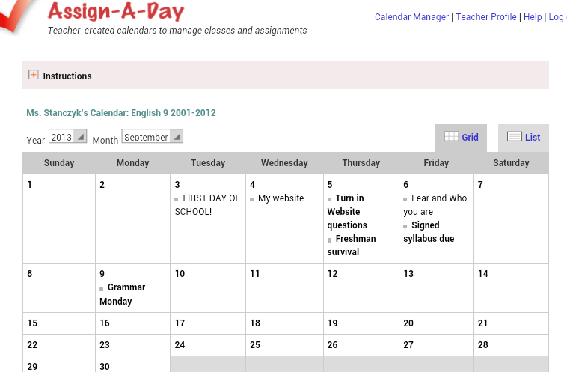
CLASSROOM PROCEDURES
YOU ARE RESPONSIBLE FOR FINDING OUT WHAT YOU MISSED.
CHECK THE WEBSITE THE DAY YOU ARE ABSENT.
WWW.STANCZYK.WEEBLY.COM
Absences
Notes:
Go to website

Slide 9
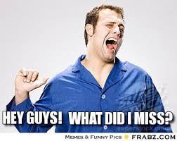
CLASSROOM PROCEDURES
I must give you three chances to turn in missing work, I’m a genie ☺ !
Here’s how I will give you that chance:
Check power school
If you have a missing assignment
You have three days to turn that work in for reduced credit…. Ta Da
MISSING
Homework
Notes:
Go to website

Slide 10
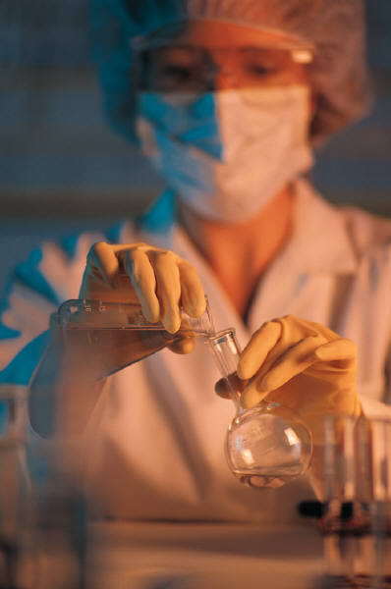
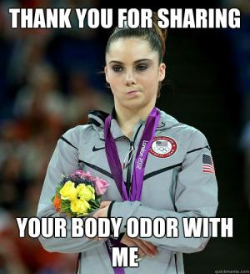
CLASSROOM PROCEDURES
KLEENEX, DESK WIPES, ANTI BACTERIAL AND LOTION ARE PROVIDED AS A COURTESY.
ONCE WE RUN OUT YOU MAY REPLENISH THEM FOR EXTRA CREDIT.
Hygiene
Notes:
Deodoratn anti persperent

Slide 11
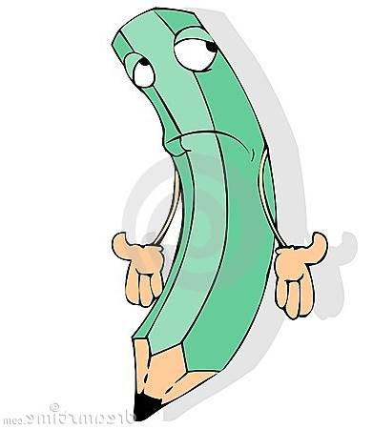

CLASSROOM PROCEDURES
ORPHAN PENS & PENCILS

Slide 12
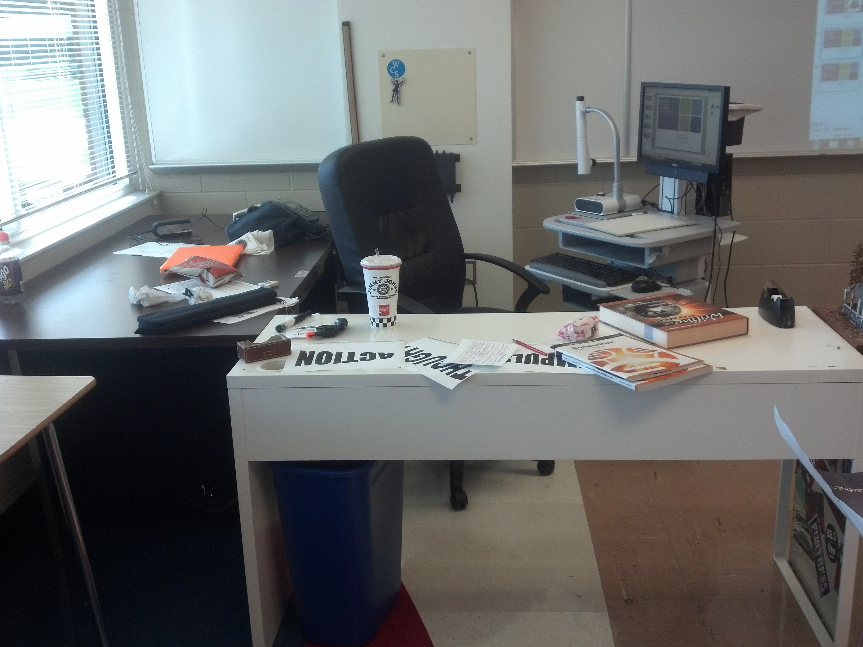
CLASSROOM PROCEDURES
MY DESKS
MY CHAIR
MY BOARD
MY COMPUTER
MY MARKERS
My Stuff

Slide 13
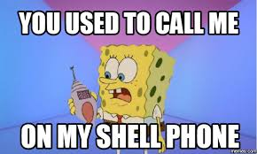
Phones
If I see them with out approval it’s a detention.
I recommend the pretty container.

Slide 14



CLASSROOM PROCEDURES
WED
Monday
And
Friday
CHECK THE BOARD
Books

Slide 15
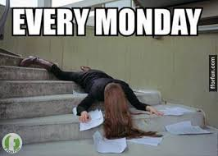
MONDAYS
INDEPENDENT READING (D.E.A.R.)
GRAMMAR- SUBJECT INTRODUCED AND NOTES GIVEN
Notes:
NEXT WEEK WE WILL GO OVER DAYS IN DETAIL- PICK OUT DEAR BOOKS; ASSESS GRAMMAR SKILLS, ETC

Slide 16
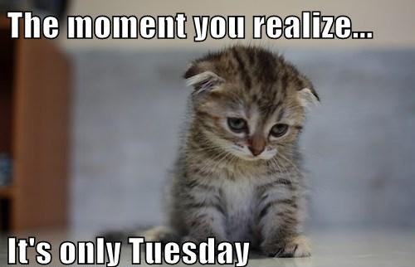
TUESDAY
WRITING
VOCABULARY
CLASS CONTENT
Notes:
SEPARATE HOURANL FOR WRITING

Slide 17

WEDNESDAY
GRAMMAR- BOOK WORK
  ASSIGNMENT WILL BE ON THE BOARD
  DUE AT THE END OF THE HOUR
Notes:
QUICK AND EASY GRADES

Slide 18
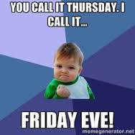
THURSDAY
WRITING
GRAMMAR PRE-TEST
CONTENT

Slide 19
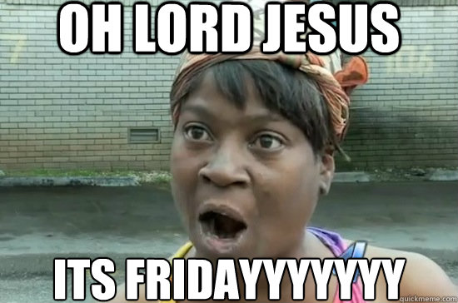
FRIDAY
GRAMMAR TEST
D.E.A.R.
CONTENT
Notes:
ASSESSMENTS GENERALLY ON FRIDAYS

Slide 20


Slide 21


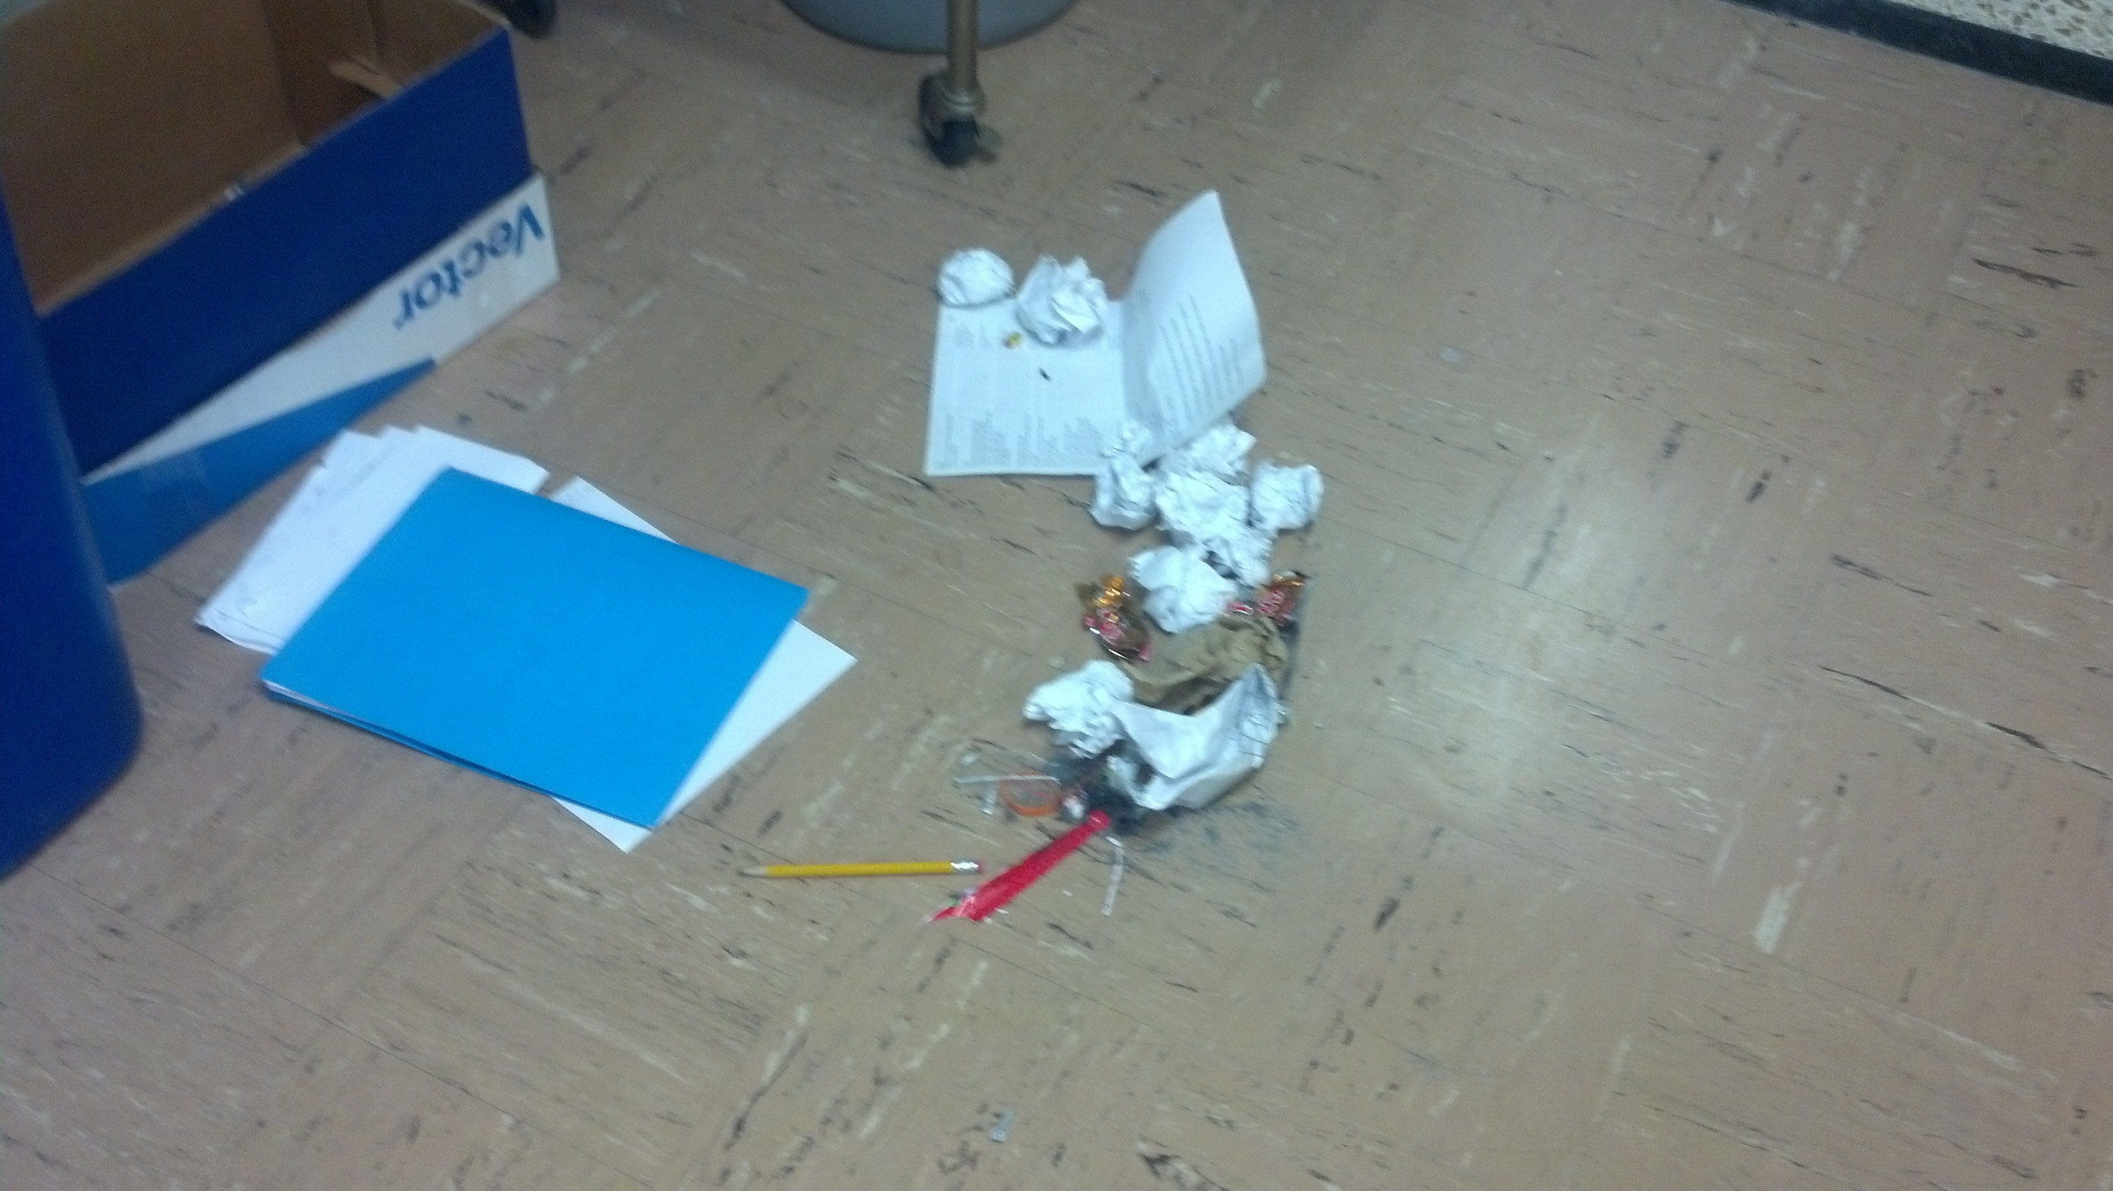
R-E-S-P-E-C-T
The floor
The books
Yourself
Your classmates
Your teacher

Slide 22
“Our deepest fear is not that we are inadequate.
Our deepest fear is that we are powerful beyond measure.
It is our light, not our darkness that most frightens us.
We ask ourselves, 'Who am I to be brilliant, gorgeous, talented, fabulous?'
Actually, who are you not to be?

