Slide 1
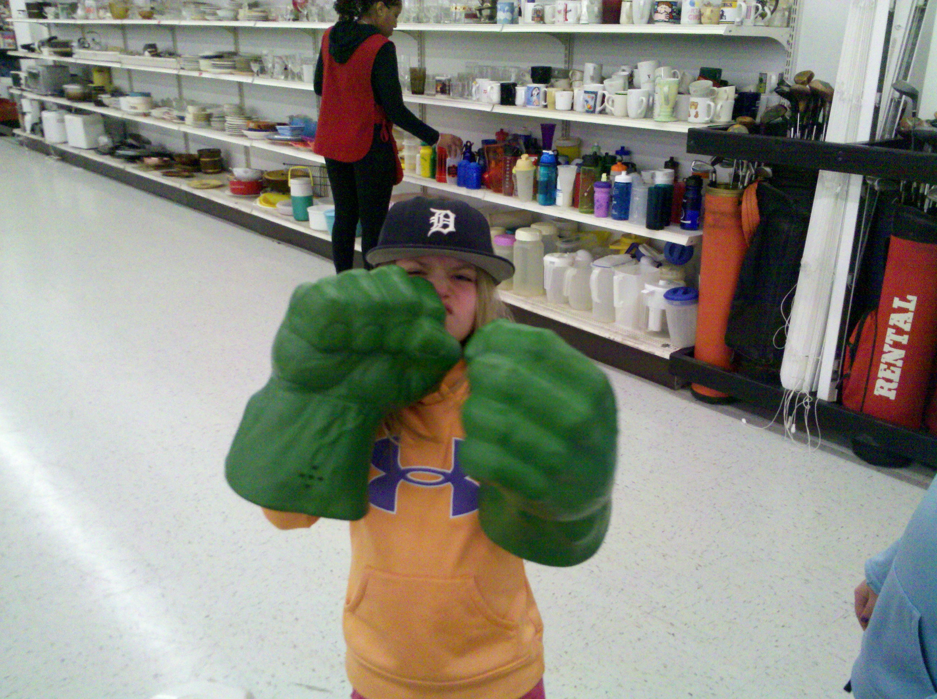


CLASSROOM PROCEDURES

Slide 2
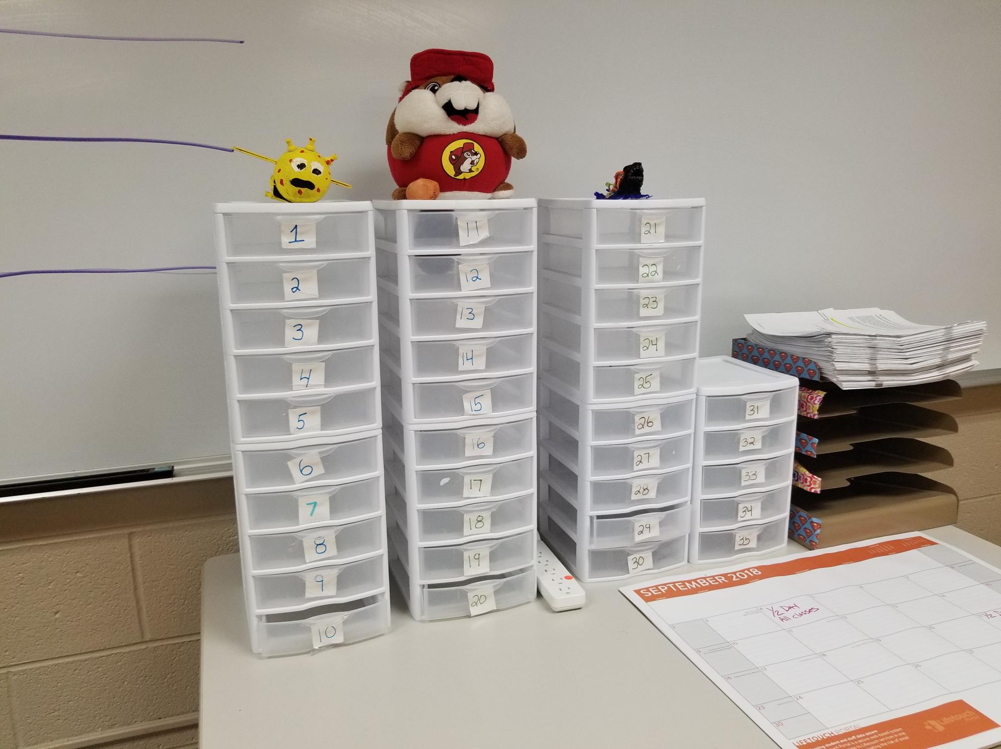

PHONES
Place them in the containers as you walk into class.
If I see them with out approval it’s a detention.

Slide 3
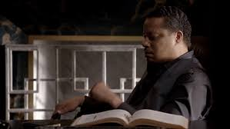
BELL WORK
Write down the date
Copy what you see on the board
Think about it, not out loud
Write down a guess at what the answer is.
The only wrong answer is doing nothing.

Slide 4
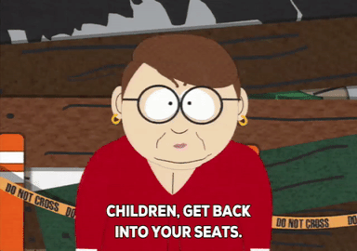
CLASSROOM PROCEDURES
SEATING CHART CHANGES EVERY MONTH.
DO NOT FEEL FREE TO MOVE AROUND, IF YOU DO SO YOU WILL LOSE POINTS.
Seats

Slide 5


CLASSROOM PROCEDURES
ONCE I HAVE TAKEN ATTENDANCE YOU ARE LATE.
AFTER 10 MINUTES YOU ARE CONSIDERED UNEXCUSED & ABSENT.
Tardies
Notes:
First hour tardy slips

Slide 6


CLASSROOM PROCEDURES
YOU ARE RESPONSIBLE
FOR :
PEN and PENCIL
2 NOTEBOOKS
CLASS BOOKS, when told
FOLDER
YOUR CLASSMATES ARE NOT YOUR OFFICE SUPPLY STORE.
Supplies

Slide 7

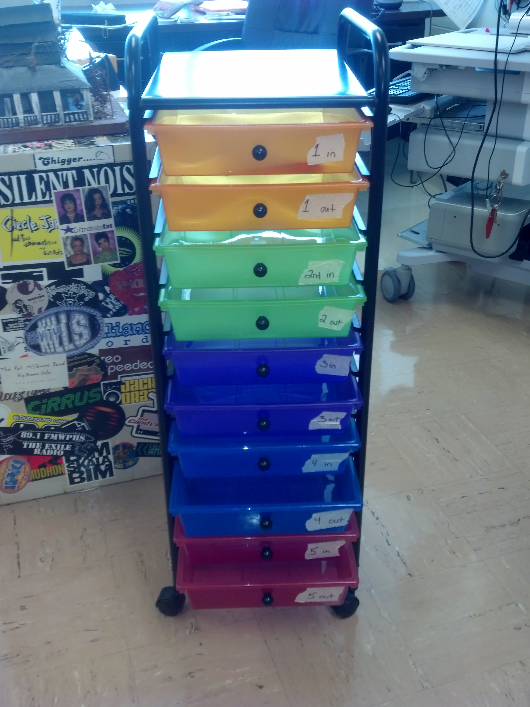
CLASSROOM PROCEDURES
USE THE HOMEWORK CART.
EACH HOUR HAS AN ASSIGNED COLOR.
Homework

Slide 8

CLASSROOM PROCEDURES
HOMEWORK GOES IN AT THE START OF CLASS.
Homework
TOP DRAWER
TO BE GRADED.
BOTTOM DRAWER IS GRADED.

Slide 9

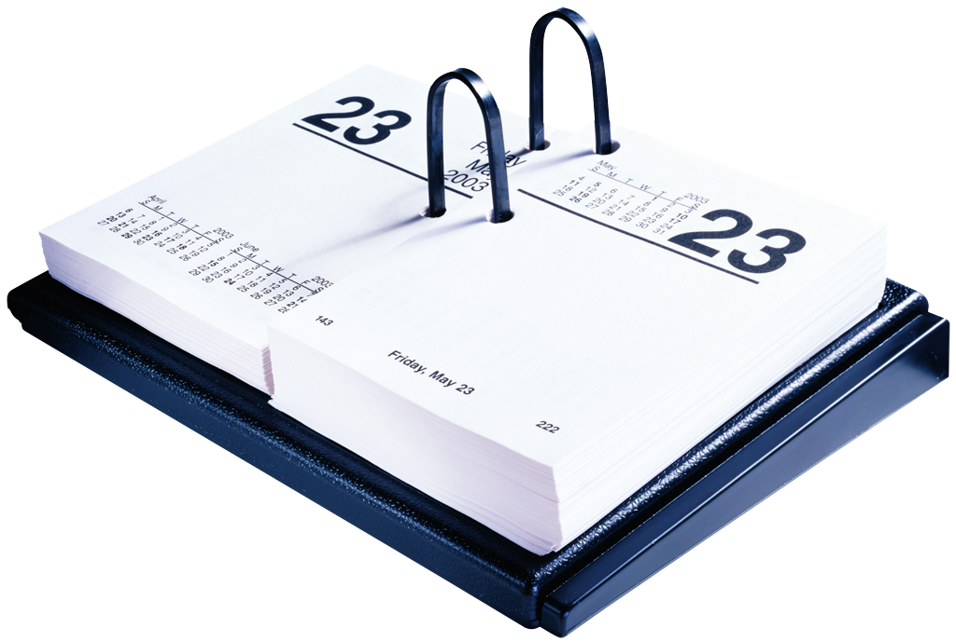
CLASSROOM PROCEDURES
YOU HAVE THE SAME AMOUNT OF EXCUSED DAYS YOU MISSED, TO MAKEUP WORK.
WRITE ABSENT ON TOP OF YOUR WORK.
Homework
Notes:
25% of grade

Slide 10

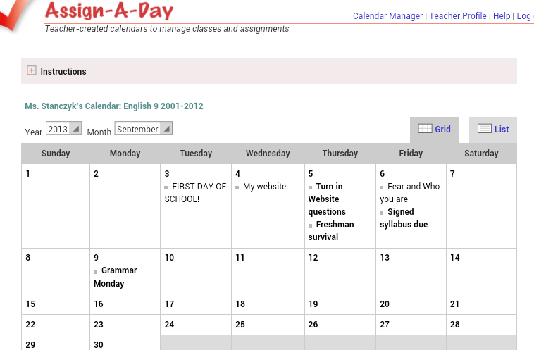
CLASSROOM PROCEDURES
YOU ARE RESPONSIBLE FOR FINDING OUT WHAT YOU MISSED.
CHECK THE WEBSITE THE DAY YOU ARE ABSENT.
WWW.STANCZYK.WEEBLY.COM
Absences
Notes:
Go to website

Slide 11

CLASSROOM PROCEDURES
I must give you three chances to turn in missing work, I’m a genie ☺ !
Here’s how I will give you that chance:
Check Power School
If you have a missing assignment
You have three days to turn that work in for reduced credit…. Ta Da
MISSING
Homework
Notes:
Go to website

Slide 12


CLASSROOM PROCEDURES
KLEENEX, DESK WIPES, ANTI BACTERIAL AND LOTION ARE PROVIDED AS A COURTESY.
ONCE WE RUN OUT YOU MAY REPLENISH THEM FOR EXTRA CREDIT.
Hygiene
Notes:
Deodoratn anti persperent

Slide 13


CLASSROOM PROCEDURES
ORPHAN PENS & PENCILS

Slide 14
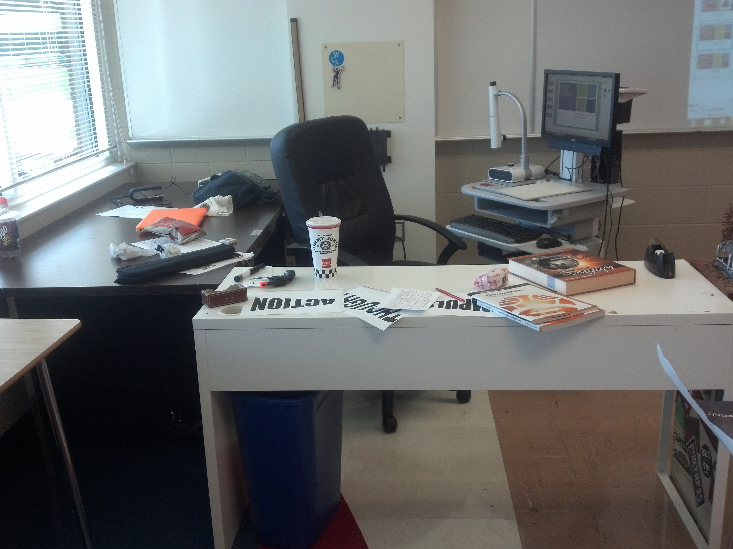
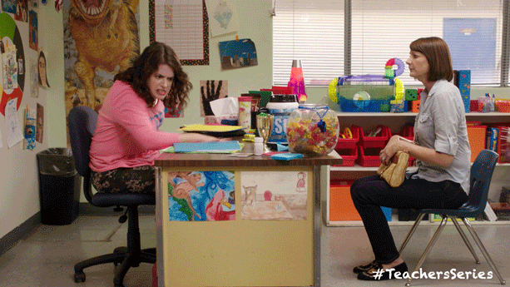
CLASSROOM PROCEDURES
MY DESKS
MY CHAIR
MY BOARD
MY COMPUTER
MY MARKERS
My Stuff

Slide 15
STOP

