Slide 1
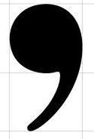
Commas,
give them a place to belong.

Slide 2

Who cares about commas?
Grandma does!

Slide 3
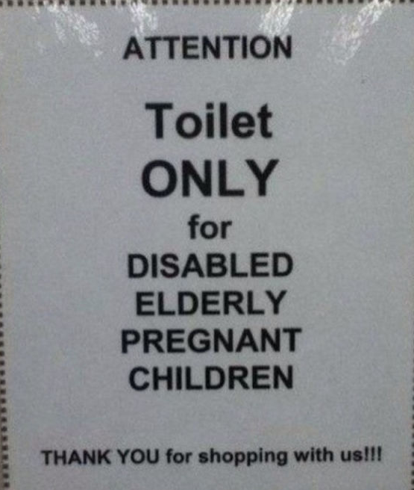
Rule number 1
Use commas to separate 3 or more items that are together.
ATTENTION
Toilet
ONLY
For
Disabled,
Elderly,
Pregnant,
Children.

Slide 4
This includes words, phrases or clauses.
Wait, is the garage in the pantry?
The buckets for the berries could be in the garage in the pantry
or on the porch.
The buckets for the berries could be in the garage, in the pantry,
or on the porch.

Slide 5
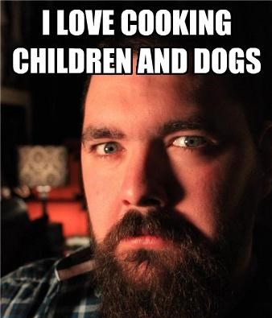
What about a series of three with one word after the word “and”?
This is often referred to as the Oxford Comma.
I say use it!
Some teachers don’t. What do you think these children would say?
I love cooking, children, and dogs.

Slide 6
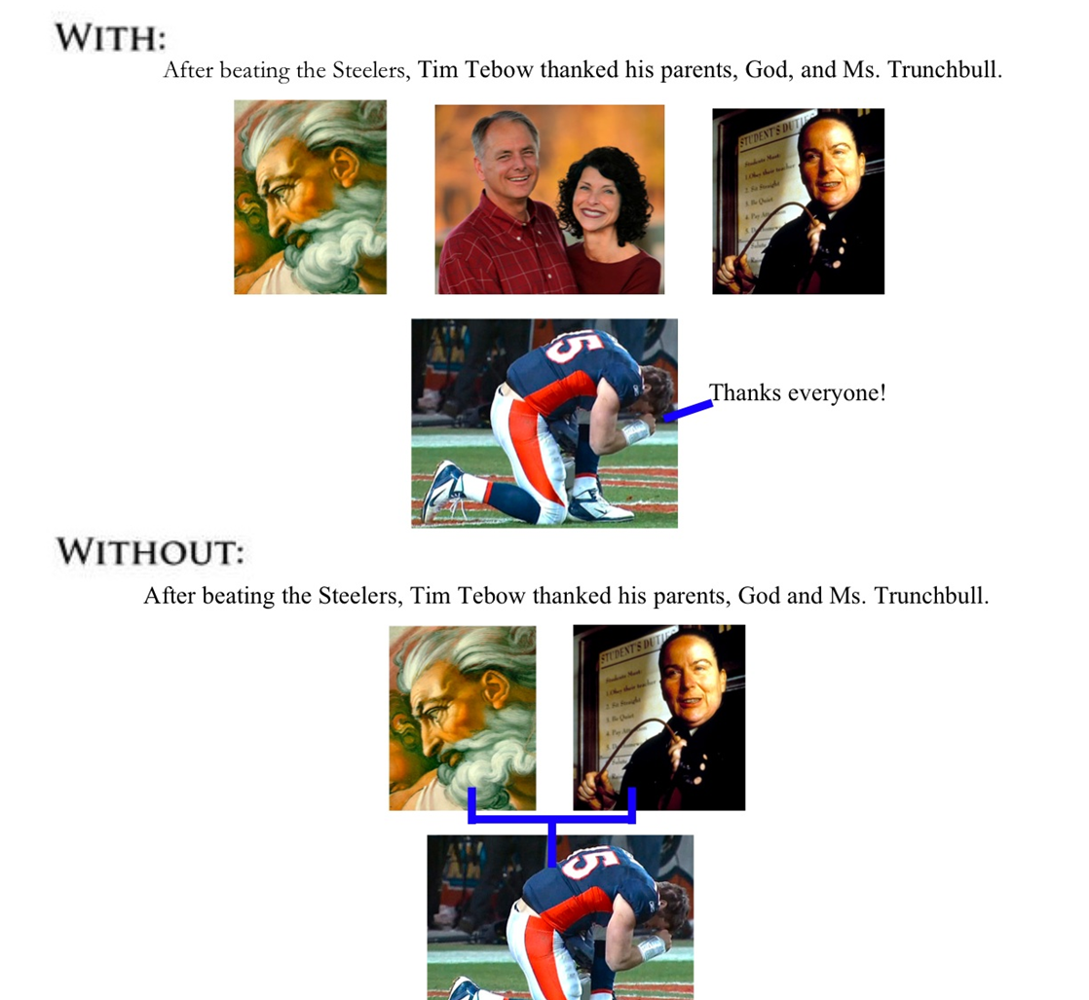
After beating the Steeler, Tim Tebow thanked his parents, God, and Mrs. Trunchbull.
After beating the Steeler, Tim Tebow thanked his parents God and Mrs. Trunchbull.

Slide 7
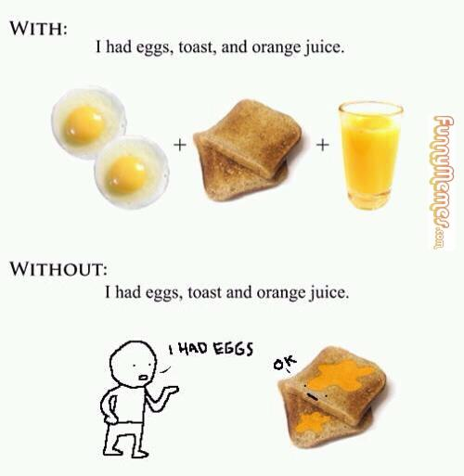

Slide 8
Rule #2
Between 2 adjectives before a noun, when there’s no conjunction.
Remember conjunctions?
For
And
Nor
But
Or
Yet
So
Today was a damp dismal day.
Adjective
Adjective
Noun
Today was a damp, dismal day.

Slide 9
Still not sure, try these hints.
If you reverse the adjectives does the sentence still make sense?
Today was a damp dismal day.
YES
Then insert a comma between them

Slide 10
If you inserted “and” between them instead of a comma would they still make sense?
Today was a damp spring day.
no
Then DON’T use a comma.

Slide 11
Rule #3
Use a comma to separate independent clauses in a compound sentence.
We waited for 2 hours, but Santa never came down the chimney.

Slide 12
Exception
Unless it’s a really short compound sentence.
Lisa ran and I fell.

Slide 13
Introductory Structures
Rule #4
Words
  No, I don’t want to see your toes.
  Yes, you should leave me alone.
  Now, walk away and never come back.
  Oh, I thought you had gone already.
  Well, that was the most awkward situation.
  Why, must you be such a psycho?
    Except when they’re part of the sentence.
      No one told me he was dead.

Slide 14
Prepositional phrases
They start with a preposition- remember those?
  Over, under, around, beside, below, with, with in, in, from, for ….. You should have a list in old notes.
Around the bend, children were hiding.
Beside the chair, there was strawberry pie.
In my life, I’ve made many mistakes.

Slide 15
Some are obvious, I hope.
Until the spring, course lists will not be published.
Inside the gym, was brightly lit and clean.

Slide 16
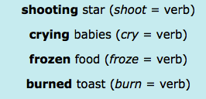
Participle phrases
Remember the verb acting like an adjective?
Start a phrase with it and you get a participle phrase
Frozen food was everywhere, while we searched for fresh food.
Crying babies can be distracting, zombie babies are deadly.

Slide 17
And
Introductory phrases that end in numbers get a comma.
In room 105, the party is just getting started.

Slide 18
Common uses you should know
Rule #5
Dates
Address
Salutations
Closings
  Check page 854 to refresh your brain

Slide 19
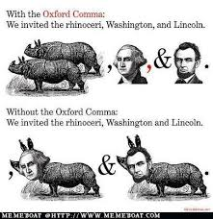

Slide 20
