Slide 1
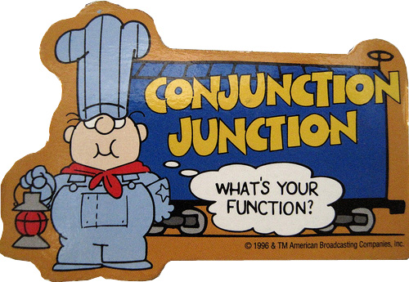
Conjunctions
It’s a connecting word

Slide 2
Coordinating conjunctions
F
A
N
B
O
Y
S
For
And
Nor
But
Or
Yet
So

Slide 3
THEY CONNECT SINGLE WORDS OR GROUPS OF WORDS
And, But, Or
Top connectors
Milk and honey, bread and butter, peas and rice
Dirty but happy, He's poor but honest, sad but true
Eat this or that, grow thin or fat

Slide 4
The rest
He is neither sane nor brilliant.
Nor, yet, for, so
They’re kind of fancy and not used as much
Judy was a racist so it’s no surprise her kids are.
John plays basketball well, yet his favorite sport is badminton.

Slide 5
Watch out for for
For is usually a prepositions
Most of the visitors were happy just sitting around in the shade, for it had been a long, dusty journey on the train.
He’s been famous for many decades.
She has been studying hard for the final exam.
John thought he had a good chance to get the job, for his father was on the company's board of trustees.
Its there to introduce the reason for the part before it

Slide 6
CORRELATIVE CONJUNCTIONS
THEY’RE PAIRS OF CONJUNTIONS
BOTH this AND that
NOT ONLY this/BUT that
EITHER him/OR her
WHETHER you do/OR you don’t
NEITHER the girl/OR the boy

Slide 7
THEY CONNECT SINGLE WORDS OR GROUPS OF WORDS
That’s the same as Coordinating conjunctions

Slide 8
INTERJECTIONS
Strong feeling or emotion
Usually at beginning of a sentence
Followed by ! Or , when feeling’s not so strong.

Slide 9
Here’s some of my favorites
Holy Hannah!
AWW Geeze!
Son of a Biscuit!
Damn!
Shoot!
Fantastic!
Spectacular!
Yuck!

