Slide 1
Fragments

Slide 2
A fragment is just an incomplete sentence

Slide 3
What makes a complete sentence?
Subject + Predicate = Complete thought.
(predicate is just a fancy word for verb)
Is this a complete sentence?
We go.
No.
Subject = We
Predicate= go
Complete thought= ????

Slide 4
Here’s and easy trick
Picture yourself sitting in class and an announcement comes on.
“We go.”
Would that make sense?
Then it’s probably a fragment a.k.a. an incomplete sentence.
What about
"I like."
"When we got in the car."

Slide 5
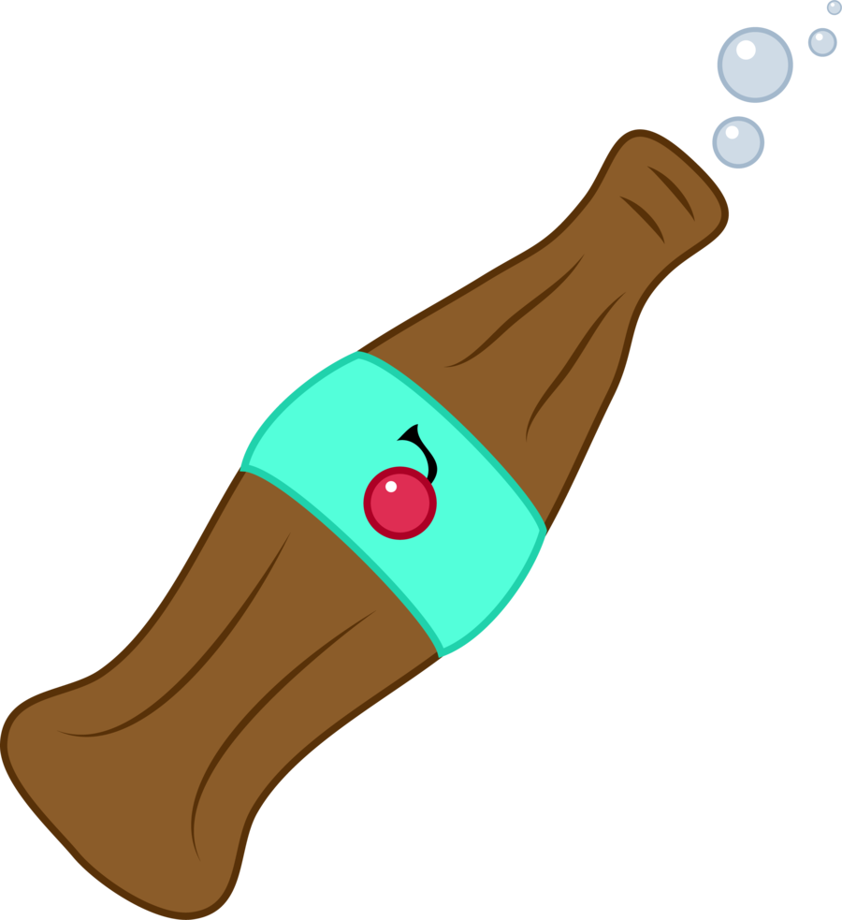
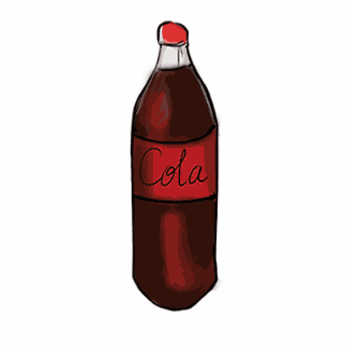
In English we just like to give one thing multiple words
Like soda and pop
Or freeway and highway
O we call an INCOMPLETE SENTENCE and FRAGMENT also.
Or.... instead of just calling something a COMPLETE SENTENCE we give it another name also

Slide 6
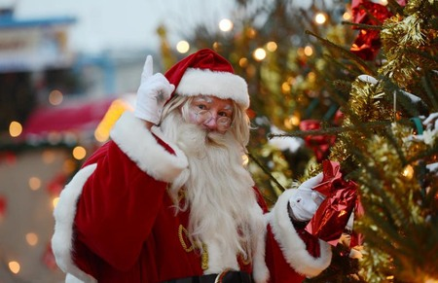
an independent clause is the same thing as a complete sentence.
Yea, Santa!

Slide 7
Are these independent clauses?
Ran into town.
The growling dog.
Not sure, try the trick.

Slide 8
Guess what we also call a fragment/incomplete sentence
A dependent clause
A subordinate clause
A whully whoo.
umm no

Slide 9
So why al the fancy names?
We call something a CLAUSE when it is part of a sentence and it has a subject and a predicate.
Both INDEPENDENT and DEPENDENT (subordinate) CLAUSES can be in the same sentence.
Which part of the sentence is DEPENDENT AND WHICH IS INDPENDENT?
If you are interested, you can read about the science of love.
Which one has a subject+predicate = complete thought?
My friend read a book that was about dopamine.
Which one has a subject+predicate = complete thought?

Slide 10
Look at these
I sit in front of the fireplace.
We go for a walk.
I like people.
These are independent clauses. The information might be sketchy, but the ideas are complete.

Slide 11
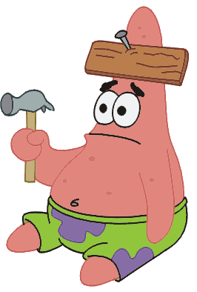
Then look at these
When it is cold.
After the dishes are put up.
Who pat my head and give me treats.
There is a subject and a verb, but the ideas are incomplete.
Remember the trick I taught you? It would sound strange if someone came on the announcements and just said this.

Slide 12
We could combine these sentences and make better ones.
When it is cold, I sit in front of the fireplace.
We go for walk after the dishes are put up.
I like people who pat my head and give me treats.
Notice the punctuation.

Slide 13
When it is cold, I sit in front of the fireplace.
When a subordinate clause begins a sentence, always put a comma after it .

Slide 14
WE GO FOR a WALK AFTER THE DISHES ARE PUT UP. I like people who pat my head and give me treats.
If the subordinate clause comes after the main clause, you usually need no punctuation

Slide 15
Here's some words to watch out for that start dependent clauses
because, before, if,
since, that, unless,
until, when, whether,
which, while, and who.

Slide 16
Review time
Is a dependent clause a complete sentence?
No
Is a dependent clause the same thig as a subordinate clause?
Yes
Do dependent clause have subject and predicates?
Yes
Do Dependent clause/Subordinate clauses express a complete thought?
No
If you start a sentence with a dependent clause what punctuation should you place at the end of it?
A comma

Slide 17
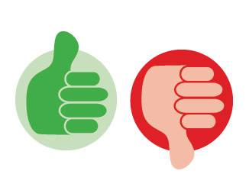
A bit more review
Is a independent clause the same as a complete sentence?
Yes
Is a independent clause a fragment?
No that's a dependent/subordinate clause
Do independent clause have a subject and predicate?
Yes
Does an independent clause express a complete thought?
Yes
If you start a sentence with an independent clause what punctuation should you end it with?
None

Slide 18
Which is an independent clause?
After he finished eating.
He drank a cup of coffee after he finished eating.

Slide 19
Which is an independent clause?
Trying to get the waiter's attention, he nodded and raised his arm.
Trying to get the waiter's attention.
Notice how the introductory subordinate clause is set off by a comma.

Slide 20
Which is an independent clause?
Standing next to his table.
There were some noisy people standing next to his table.

Slide 21
Which are independent clauses?
The man having read the paper.
Having read the paper, the man decided to leave.
The man decided to leave since he had read the paper.

