Slide 1

Gerunds
Verb used as a noun
They end in “ing”

Slide 2
Yes they usually end in -ing but so to participles.
THE DIFFERENCE
A Gerund is used as a noun- not an adjective.
Shooting is modifying class
It’s a verb acting like an adjective = participle
I might take a shooting class.
I earn extra money by shooting.
Shooting is a thing
It’s a verb acting like a noun =
gerund

Slide 3

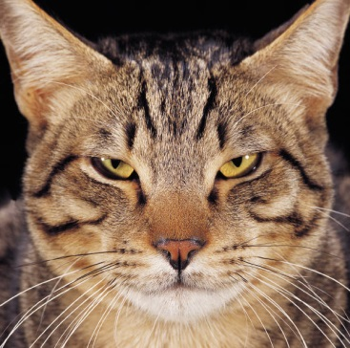
You may be confused thinking a Gerund is just a regular old verb
Try substituting it with a regular noun, it should work.
I earn extra money by shooting.
I earn extra money as a hired gun.
My cat's favorite activity is sleeping.
My cat's favorite activity is nap time.

Slide 4

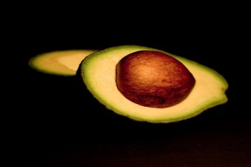
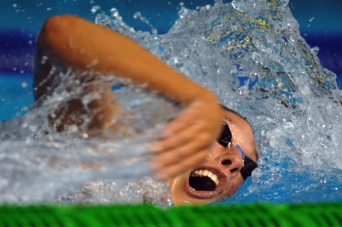
Find the Gerund
Sleeping is my favorite activity.
Do you enjoy skinning?
I gave driving my full attention.
The lifeguard stopped her from sinking.

Slide 5
Gerund or Participle
The participle will be modifying a noun
Many teenagers start working to make extra money.
Others become working people to help their family.
Bob took a skinning class to improve his skills.
Skinning is one way to earn extra money.

Slide 6
Infinitives
Verb form that begins with “to”.

Slide 7
Pretty simple
In the 1960s and 1970s, Muhammad Ali was the boxer to see.
His life is interesting to research.
He had one goal, to win.
To win he had to box.

Slide 8
That’s too simple
Prepositional phrase can also start with “to”
Infinitive is to + verb form.
Prepositional phrase is to + noun or a pronoun.

Slide 9
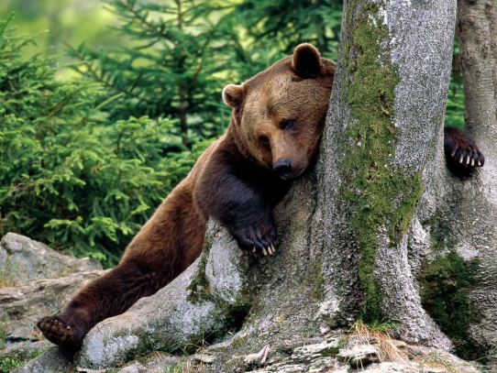
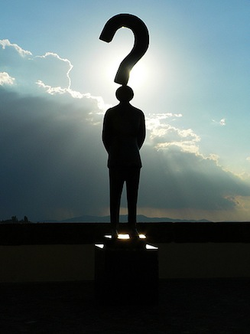
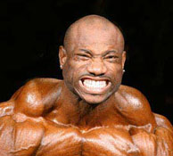
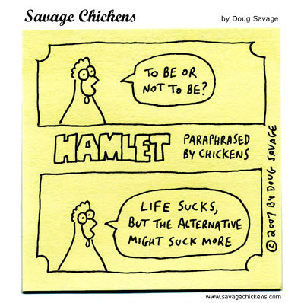
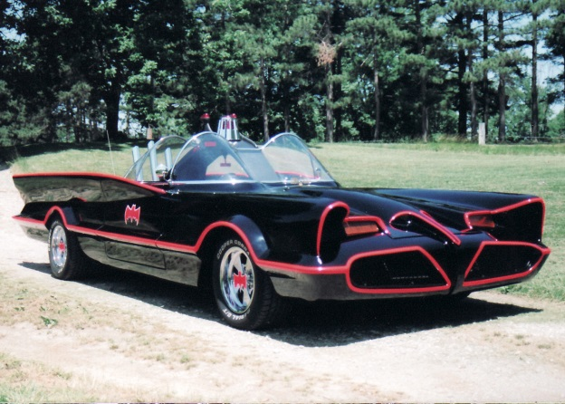
Infinitive or prepositional phrase
We need some time to rest.
What do you want to do?
To be or not to be, that is the question.
Should I go to gym?
To the batmobile!

Slide 10
Let’s put all our verbals together
Participles
Gerunds
Infinitives
Crap! What’s a participle again?
Verb acting like an adjective.

Slide 11
Participle, Gerund or Infinitive?
Steam is water expanded sixteen hundred times.
The first apples to reach America arrived from England in 1629.
He was sentenced to death by hanging.

