Slide 1
Participle or Appositive
Participle looks like a verb
Appositive is a Noun, commas around it,

Slide 2
The exhausted singers bowed before the cheering fans.
Appositive or participle
participle

Slide 3
My captain, Odysseus didn’t listen to me.
Appositive or participle
Appositive

Slide 4
During our journey we met a
Cyclops, Polyphemus.
Appositive or participle
Appositive

Slide 5
The screaming fans surrounded the thrashing musicians.
participle

Slide 6
My sister, Laura Stanczyk, owns a casting agency in New York.
Appositive

Slide 7
Participle or verb
Notes:
Participle could be a verb
Appositive modifies a noun and are attached to it

Slide 8
Biting flies made us leave the campground.
a Participle b Verb
Notes:
Both modify nouns
Participle could be a verb
Appositive modifies a noun and are attached to it and are nouns

Slide 9
The talking bear was an illusion.
a participle b Verb
Notes:
Both modify nouns
Participle could be a verb
Appositive modifies a noun and are attached to it and are nouns

Slide 10
Grinning broadly, Julia obviously brought good news.
a participle b Verb
Notes:
Both modify nouns
Participle could be a verb
Appositive modifies a noun and are attached to it and are nouns

Slide 11
Adjectival or adverbial

Slide 12
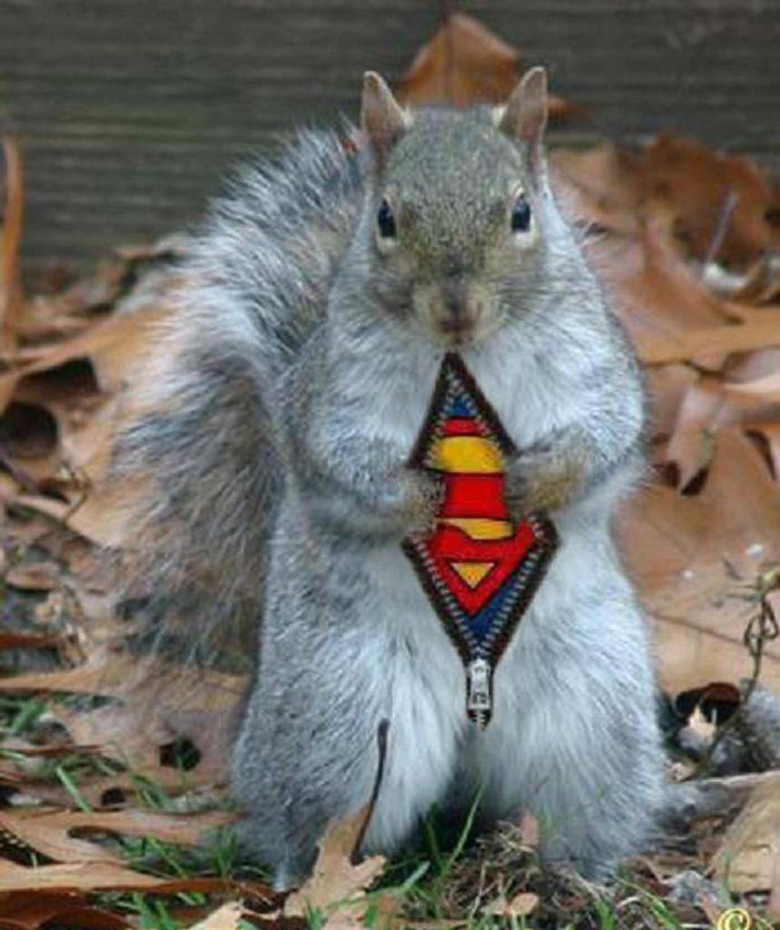
What’s a preposition?
REMEMBER THE SQUIRREL!
ANY WHERE A SQUIRELL CAN GO.
OVER
UNDER
UP AROUND
IN BETWEEN
Etc.
There’s a big list on page 610

Slide 13
Prepositions

Slide 14
A prepositional phrase
IS A PHRASE:
THAT BEGINS WITH A PREPOSITION
ENDS WITH A NOUN OR A PRONOUN

Slide 15
Dogs can be great friends
to humans.
find the prepositional phrase
Is it modifying a noun
Is it modifying a verb, adjective or adverb
ADJECTIVAL

Slide 16
We will meet by the flagpole.
find the prepositional phrase
Is it modifying a noun
Is it modifying a verb, adjective or adverb
Adverbial

Slide 17
Liz’s laughed loudly in the gym.
find the prepositional phrase
Is it modifying a noun
Is it modifying a verb, adjective or adverb
Adverbial

Slide 18
That dog with the red collar on the porch is mine.
find the prepositional phrase
Is it modifying a noun
Is it modifying a verb, adjective or adverb
Adjectival

Slide 19
Adjectival or just Prepositional

Slide 20
Adjectival or adverbial
The teacher lives in a brand new apartment.
Prepositional Phrase
Adjectival Phrase

Slide 21
The people in the park are walking.
Prepositional Phrase
Adjectival Phrase

Slide 22
My friend John wore a hat with a button of the Earth saying "home."
Prepositional Phrase
Adjectival Phrase
None of the above

Slide 23
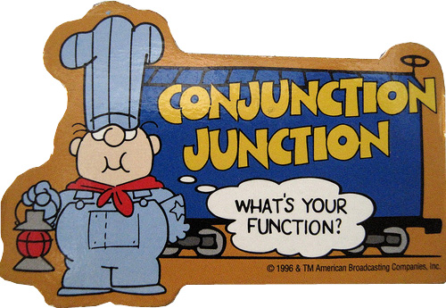
Conjunctions
It’s a connecting word

Slide 24
Coordinating conjunctions
F
A
N
B
O
Y
S
For
And
Nor
But
Or
Yet
So

Slide 25
CORRELATIVE CONJUNCTIONS
THEY’RE PAIRS OF CONJUNTIONS- and pairs stay together
BOTH this AND that
NOT ONLY this/BUT that
EITHER him/OR her
WHETHER you do/OR you don’t
NEITHER the girl/OR the boy

Slide 26
It is sunny outside today, so I think I will just wear a sweater.
coordinating
correlative

Slide 27
Not only Keith but also Bradley are good at xbox.
coordinating
correlative

Slide 28
They planned several years for this child's arrival.
correlative
coordinating

