Slide 1
Being Greek wasn't such a great deal

Slide 2
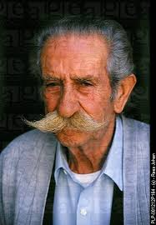
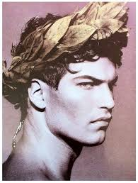
There were two types of Greeks
The wealthy
Everyone else

Slide 3
The Wealthy were in charge
They had fancy parties

Slide 4
AND DIDN'T WORRY ABOUT MUCH

Slide 5
EVERYONE ELSE WAS POOR
THIS SUCKS

Slide 6
YOU WERE EITHER A SLAVE

Slide 7
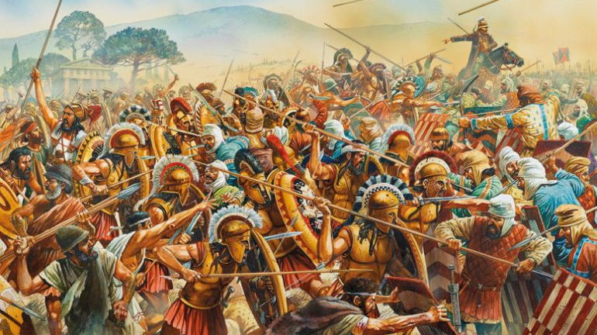
SOME SOLDIER SENT TO DIE

Slide 8
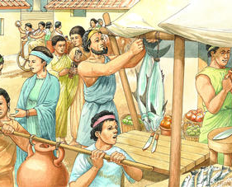
OR SOME POOR SUCKER TRYING TO MAKE A BUCK

Slide 9
IF MY LIFE SUCKED THAT HARD I MIGHT TRY TO CHANGE IT
Today I could hop on google find a new town, new job, plan my trip, check the weather, start a protest, find my long lost brothers…

Slide 10
BUT IF YOU WERE GREEK

Slide 11
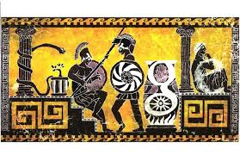
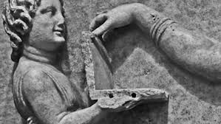
THERE WAS NO GOOGLE

Slide 12
NO LITTLE SCREENS
Why isn’t she texting back?

Slide 13
NO BIG SCREENS
NO GIANT FLAT SCREEN

Slide 14
THERE WAS NO NETFLIX

Slide 15
NO PICTURES
NO INSTAGRAM,
NO GREEK FILTER ON SNAP CHAT
NO PHOTOS

Slide 16
NO RADIOS
They didn’t even have cool boom boxes
Or car radios

Slide 17
NOT EVEN MANY BOOKS
NO KINDLE
NO WAP PAD
NO BOOKS
HELL MOST OF THEM COULDN’T EVEN READ

Slide 18
THEY JUST DIDN’T KNOW MUCH MORE THAN WHAT THEY SAW EVERYDAY AND WHAT THEY WERE TOLD

Slide 19
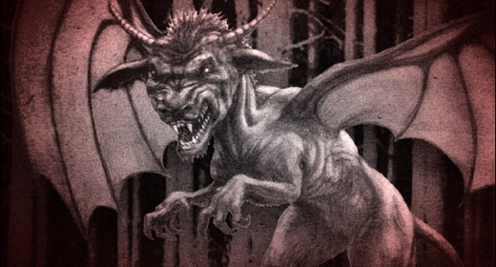

Slide 20
THE GUYS IN POWER NEEDED TO DO 2 THINGS
1. KEEP THE PEOPLE IN LINE
2. KEEP THE PEOPLE FROM THINKING TOO MUCH

Slide 21
SO THEY GOT DUDES LIKE HOMER

Slide 22
NOT THAT HOMER

Slide 23
HE WAS A STORYTELLER
AND HE SCARED THE CRAP OUT OF PEOPLE.

