Slide 1
Infinitives
Verb form that begins with “to”.

Slide 2
Pretty simple
In the 1960s and 1970s, Muhammad Ali was the boxer to see.
His life is interesting to research.
He had one goal, to win.
To win he had to box.

Slide 3
That’s too simple
Prepositional phrase can also start with “to”
Infinitive is to + verb form.
Prepositional phrase is to + noun or a pronoun.

Slide 4
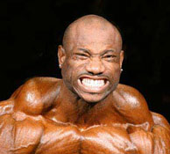
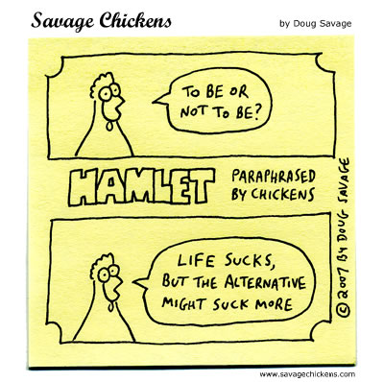
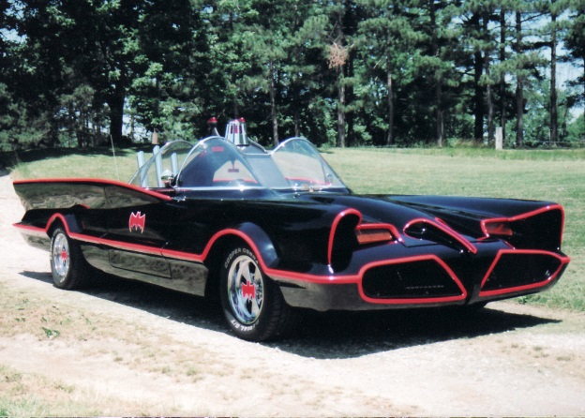
Infinitive or prepositional phrase
We need some time to rest.
What do you want to do?
To be or not to be, that is the question.
Should I go to gym?
To the batmobile!

Slide 5
There are a few infinitives that are special and don’t use To + Verb
But we let 10th grade teachers worry about that!
One rules you should know is that most of the time You DON’T SPLIT INFINITVES
In other words don’t put something in between the To and the Verb

