Slide 1
Making your story Greek

Slide 2
Setting
Distant land
Exotic or Mysterious

Slide 3
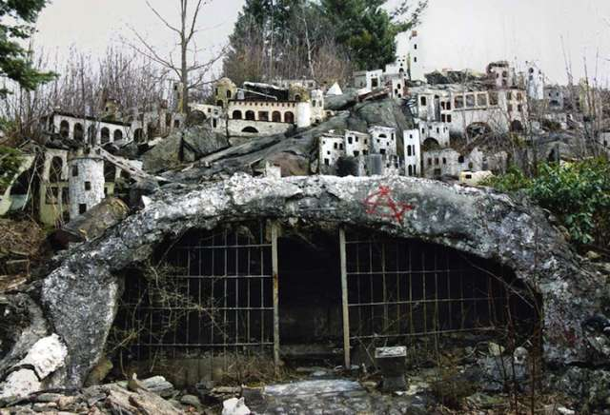
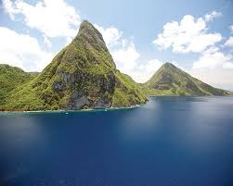
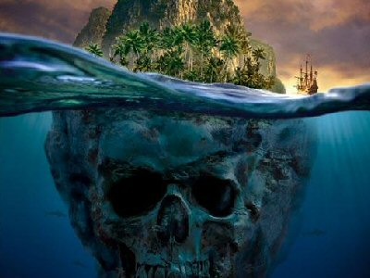

Slide 4
Characters
Gods
Monsters
Hero

Slide 5
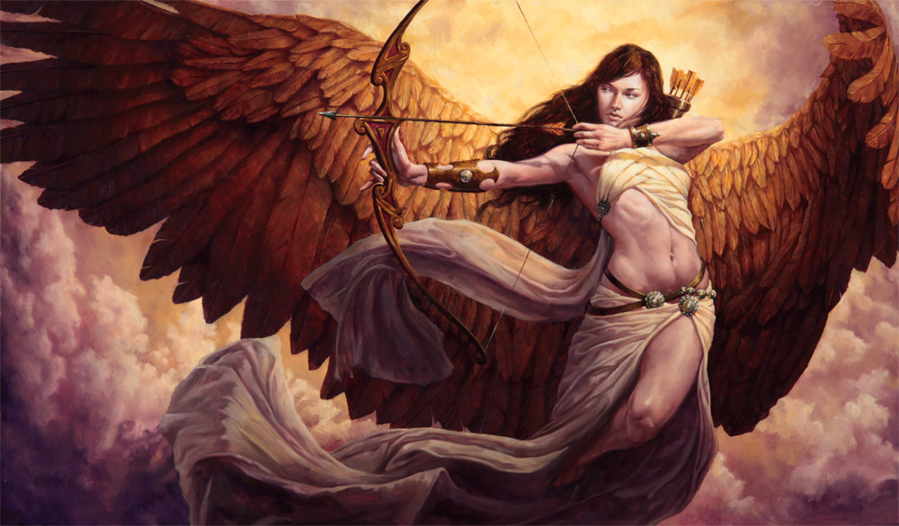
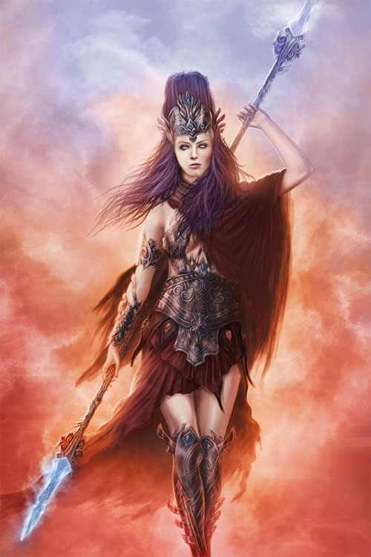
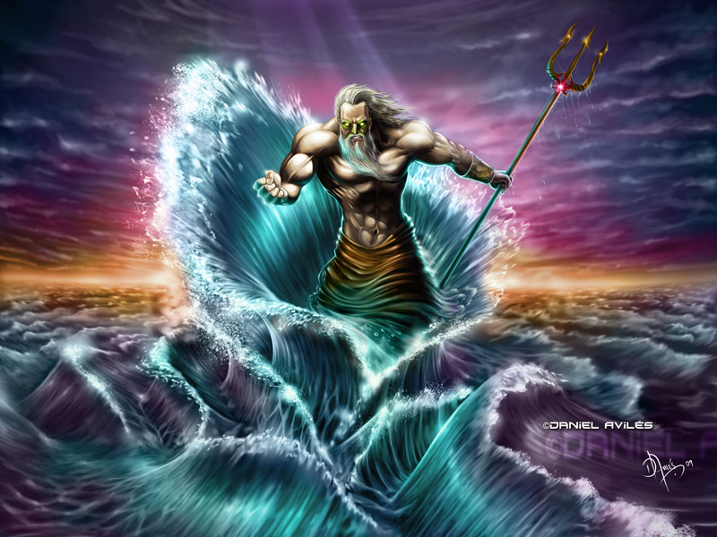

Slide 6
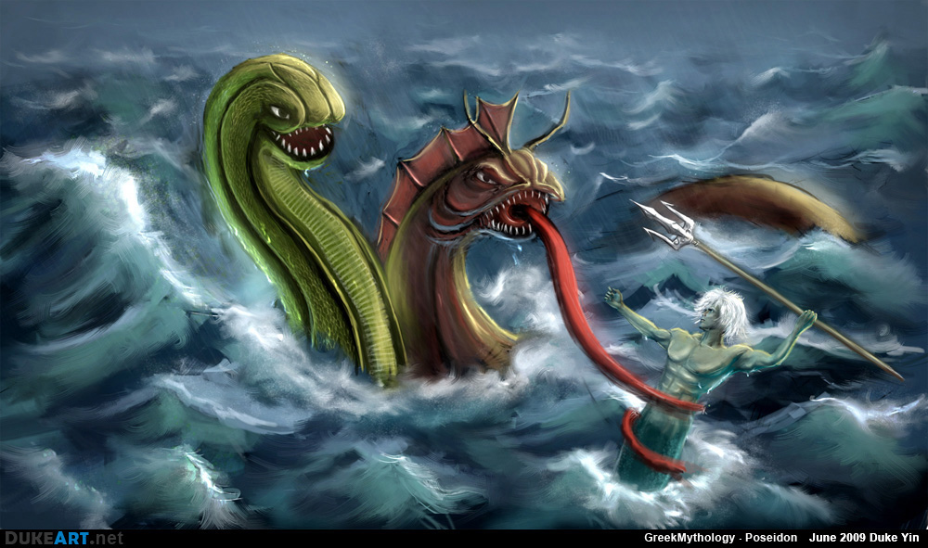
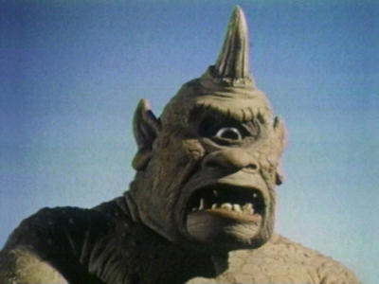
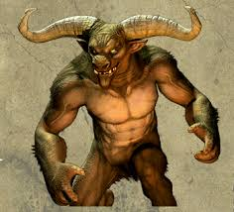

Slide 7
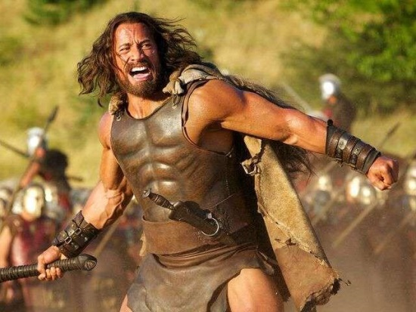
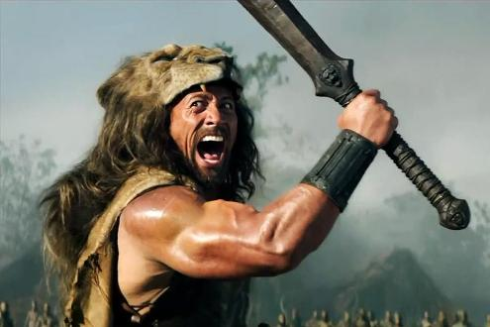
Brave; smart; leader; flawed

Slide 8
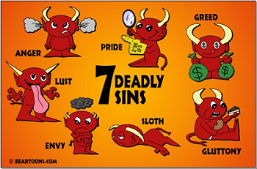
Plot
Some flaw gets them in trouble
Think of the seven deadly sins

Slide 9
Conflict
Hero vs some God or Monster
Man vs Man; Man vs Nature; Man vs Self
Hero wins but people die

Slide 10
Annotate for
Setting-
Characters- gods; monsters, Hero
Character flaw
Conflict
find 2 examples of imagery
2 metaphors or similes
Questions you have
One deep thought

