Slide 1
Verbals

Slide 2
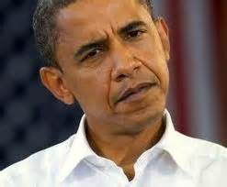
Verbals
When a word could be a verb but
it’s used as another part of speech
Used like adjectives- Participles
Used like Nouns- Gerunds
Used like Noun, adjective or an Adverb- Infinitives

Slide 3
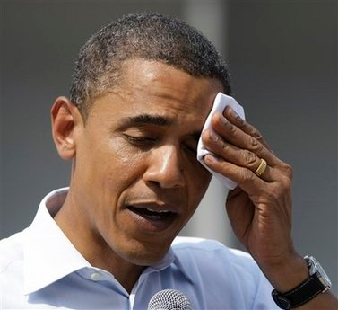
Let’s just focus on Participles

Slide 4
Participles are when
Verbs are acting like an Adjective
Adjective modify nouns
Verbs state action or being
Running
Injured
Surprised
Run
Injure
Surprise
Is
Are
Was
Men
Heart
Winner
Write down 5 adjectives right now!
Write down 5 verbs right now!

Slide 5
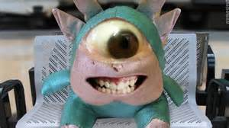
Here’s a verb acting like a verb should.
The Cyclops screamed and delighted everyone.
See how screamed and delighted tell you what the Cyclops was doing.

Slide 6
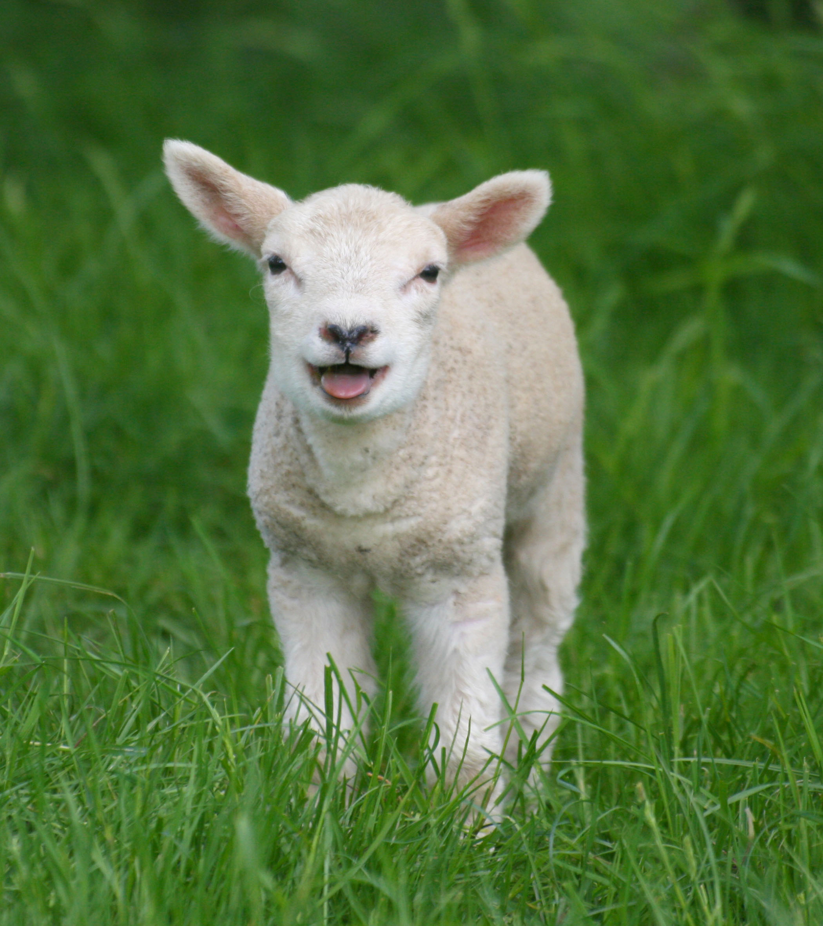
Here are words that could be verbs acting like adjectives
The screaming Cyclops was surrounded by delighted sheep.
PARTICIPLE
See how screaming adds to the proper noun Cyclops.
See how delighted adds to sheep.

Slide 7
It’s a participle IF
1. It could be a verb in a different sentence
It’s not the main verb in the sentence
2. It’s modifying a noun/pronoun
3. Answers Which one or What kind.
Screamed was delighted
screaming Cyclops
delighted sheep
Which Cyclops?
the screaming one
What kind of sheep?
The delighted ones

Slide 8
Try it
The crying baby drew a long breath and sucked in a spider crouching in the corner of the crib.
What could be a verb ? Eliminated the main verb. (what the subject did)
The crying baby drew a long breath and sucked in a spider crouching in the corner of the crib.

Slide 9
Are any of those verbs modifying
nouns?
The crying baby drew a long breath and sucked in a spider crouching in the corner of the crib.

Slide 10
3. Does it answer Which one or What kind?
PARTICIPLE
Which baby? The crying baby
Which spider? The crouching spider

Slide 11
Try it
The mangled pair of sunglasses, bruised face, broken arm, and bleeding knees meant Odysseus had taken another spill on his ram.
What looks like verbs? Eliminated the main verb. (what the subject did)

Slide 12
Are any of those verbs modifying
nouns?
The mangled pair of sunglasses, bruised face, broken arm, and bleeding knees meant Odysseus had taken another spill on his ram.

Slide 13
3. Does it answer Which one or What kind?
The mangled pair of sunglasses, bruised face, broken arm, and bleeding knees meant Odysseus had taken another spill on his ram.

Slide 14
The mangled pair of sunglasses, bruised face, broken arm, and bleeding knees meant Odysseus had taken another spill on his ram.
PARTICIPLE

Slide 15
Try it
The exhausted singers bowed before the cheering fans.
What looks like verbs? Eliminated the main verb. (what the subject did)

Slide 16
Are any of those verbs modifying
nouns?
The exhausted singers bowed before the cheering fans.

Slide 17
3. Does it answer Which one or What kind?
The exhausted singers bowed before the cheering fans.

Slide 18
Try it now with the steps in your notes
The screaming fans surrounded the thrashing musicians.

Slide 19
Their manager, surprised and frightened, pulled them off the stage.

Slide 20
One last bit about participles
Present participles end in ING
Past participles usually end in ED, sometimes n, t, or en

Slide 21
Present or past participle
Burning
Discarded
Hushed
Torn
Howling
Bent

