Slide 1
Prepositional Phrases

Slide 2
What’s a phrase?
DOES NOT HAVE A SUBJECT AND A VERB

Slide 3
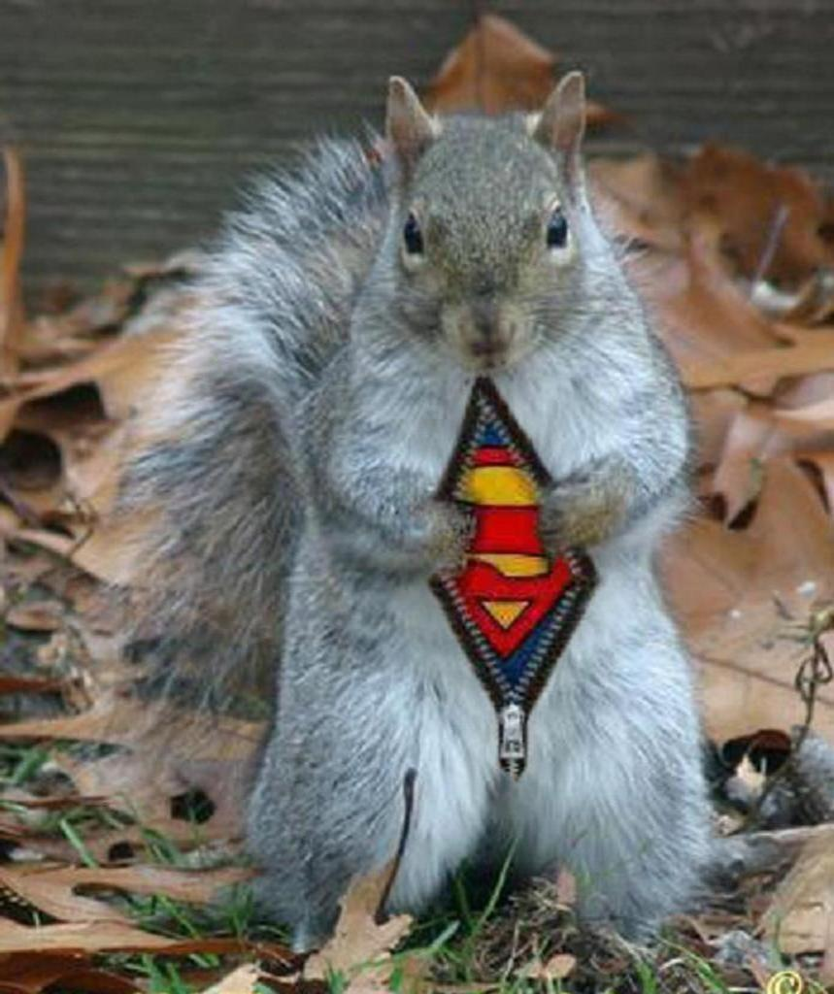
What’s a preposition?
REMEMBER THE SQUIRELL!
ANY WHERE A SQUIRELL CAN GO.
OVER
UNDER
UP AROUND
IN BETWEEN
Etc.
There’s a big list on page 610

Slide 4
A prepositional phrase
IS A PHRASE:
THAT BEGINS WITH A PREPOSITION
ENDS WITH A NOUN OR A PRONOUN

Slide 5
CHECK IT OUT
Why don’t you go between Odysseus and Polyphemus?
Between is a preposition
Polyphemus is a pronoun
Prepositional phrase

Slide 6
Try it
The man beneath the rock was useless on the ship.
Do you see a prepositions?
Is it part of a phrase ( does it end in a noun or pronoun)
The man beneath the rock was useless on the ship.

Slide 7
Adjectival phrase

Slide 8
Remember what an adjective does?
Modifies (adds to) a noun or pronoun
Answers
Which one
What kind
Not just a monster but a despicable monster.

Slide 9
Adjectival Phrase
Is a prepositional phrase
Modifies (adds to) a noun or pronoun
Which one
What kind

Slide 10
Check it out
The God with the thundering voice is a troublemaker.
Find your prepositional phrase
Does the prepositional phrase modify (add to) a noun or pronoun?
Not sure?
Does it answer which one or what kind?

Slide 11
Try it
Please give him the wrath of the gods.
Is there a prepositional phrase
Does the prepositional phrase modify (add to) a noun or pronoun?
Not sure?
Does it answer which one or what kind?

Slide 12
Try again
The God with the small hammer is a pest.
Is there a prepositional phrase
Does the prepositional phrase modify (add to) a noun or pronoun?
Not sure?
Does it answer which one or what kind?

Slide 13
Adverbial phrase

Slide 14
Yup, you guessed it What’s an adverb?
Adverb modifies (adds to) verb; adjective or adverb
Remember adverbs answers
Where
When
How
To what extent

Slide 15
So, Adverbial phrases
Are prepositional phrases
That add to a verb, adverb, or adjective

Slide 16
Try it
We should meet at the park.
Is there a prepositional phrase?
Does it add to and verb, adjective or adverb
Does it answer
Where
When
How
To what extent

Slide 17
Try it again
We will meet by noon.
Is there a prepositional phrase?
Does it add to a verb, adjective or adverb
Does it answer
Where
When
How
To what extent

Slide 18
Misplaced Modifiers
A modifier usually comes right before or right after what ever it is modifying.
When it doesn’t it is often confusing, and is MISPLACED.

Slide 19
On the stage the audience applauded for the performers.
This sounds like the audience is on the stage.
The audience applauded for the performers on the stage.
This makes more sense.

Slide 20
Try it
Which one is correct?
The actor told us about his career in the dressing room.
In the dressing room the actor told us about his career.

Slide 21
Adjectival or Adverbial
As a boy, Zeus played with is father ‘s minions.
ADVERBIAL

Slide 22
Adjectival or Adverbial
As a boy, Zeus played with is father ‘s minions.
ADVERBIAL

Slide 23
Adjectival or Adverbial
At the age of ten, he entered a school for Gods in Troy
ADVERBIAL

Slide 24
Adjectival or Adverbial
At the age of ten, he entered a school for Gods in Troy
ADJECTIVAL

Slide 25
Adjectival or Adverbial
At the age of ten, he entered a school for Gods in Troy
ADJECTIVAL

