Slide 1
Prepositions usually indicate location
And not just where but when.

Slide 2
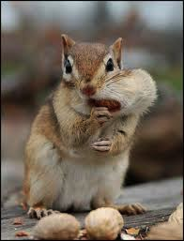
Think of a Squirrel

Slide 3
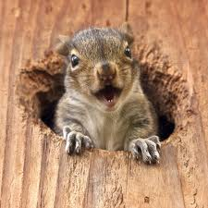
If a squirrel can go there (Position), it’s probably a Preposition
In a hole

Slide 4
I’m going with my friend, Rover.

Slide 5
The squirrel is on top of a Tiger

Slide 6
The squirrel is under a tree.

Slide 7
The squirrel is between two trees.

Slide 8
The squirrel orbited the moon in the morning.

Slide 9
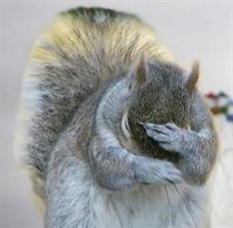
See how the prepositions is usually in the middle of a sentence.
That’s because prepositions can’t stand to be alone.
They need thier object .

Slide 10
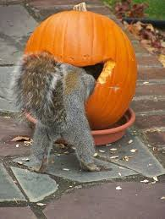
The squirrel is in front of the pumpkin
Object
See how the prepositions show a relationship between a noun and another word(object) in the sentence.

Slide 11
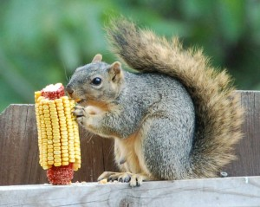
The squirrel is beside the corn.
What’s the preposition?

Slide 12
The squirrel is inside the pumpkin
What’s the noun and other word
What’s the preposition?

Slide 13
There's a list of common prepositions on page 560

Slide 14
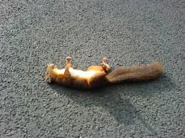
The list doesn’t always work

Slide 15
There are these Prepositions
To
Unlike
Until
With
Within
without
Except
Despite
Concerning
During
From
For
Regarding
Since

Slide 16
There are compound prepositions ( made up of two or more words)
According to
By means of
Instead of
In spite of
In place of
In case of
Except for

Slide 17
Because of the squirrel the war was won.

Slide 18
Prepositional Phrases
Include a preposition and it’s object which will be a noun…
because prepositions are not loners.

Slide 19
Prepositional Phrases
At school there are squirrels.
At = preposition; school = noun.
According to Mr. Smith squirrels are delicious.
According to = preposition;
Mr. Smith = Proper noun
Under the stove there are baby squirrels.
Under = preposition; the = modifier; stove = noun.

Slide 20
Is it an adverb or a preposition?
Prepositions require an object ( which will be a noun)
Dorothy colors outside the lines.
Adverbs don’t
Dorothy will go outside.
ADVERBS WILL BE ALONE

Slide 21
Look after the word that follows
If there is a noun acting as an object of that word, it’s a preposition
The squirrel went down the tree.
The squirrel needs to settle down.

Slide 22
Dean thinks that he is smarter than everyone in the class.
How many prepositions are in this sentence?
What is the object?

Slide 23
Will you put these cookies on the tray?
How many prepositions?
What’s the object

Slide 24
Without a care in the world, Alex is relaxing, waiting for the game.
There are two prepositions- what are they?
What are their objects

Slide 25
Is this a prepositional phrase?
When the squirrel attacks from within death is imminent.
During the winter, according to legend, squirrels grown fangs.
The dominant squirrel often is found between tribes.
The dominant squirrel often is found between tribes.

Slide 26
Preposition or Adverb?
He broke his leg when he went down.
He went down to the store.
The squirrel outside is plotting his revenge.
The squirrel is outside his domain.
I fell before the squirrel.
Before I fell the squirrel snickered.

Slide 27
