Slide 1
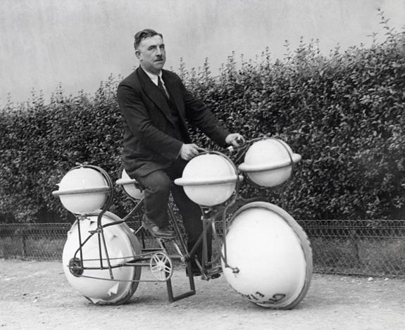
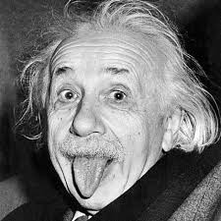
SUBJECT
Thing- Many inventions
Person- Einstein
Place- Austria
Names the person, place , thing or idea that the sentence is about.
Idea- His intelligence

Slide 2
The cow walking down the stairs in the video fell.
His creative genius was in question after making the video.
The dark forest in the video was creepy
So many people have watched the video it scares me.

Slide 3
Linking Verbs
The other word renames or
describes the subject
Links the subject with another word in the sentence.

Slide 4
My captivity in the classroom was disturbing.
High school memories should not be so dark and evil.
My teacher could have been a minion for Satan.
Instead, she was an English teacher.
WAS
The other word renames or
describes the subject
SHOULD NOT BE
COULD HAVE BEEN
WAS

Slide 5
Some of you smarty pants noticed what we call a VERB PHRASE
Should not be
Could have been
THEY HAVE A HELPING VERB (OR AUXILLARY VERBS)

Slide 6
HERE’S A LIST OF HELPING VERBS
am, are, is,
was, were,
be, being, been
have, has, had
shall, will,
do, does, did
may, must, might
can, could, would, should
YOU DON’T NEED TO IDENTIFY THEM ON THE TEST FRIDAY, JUST KNOW THAT THEY CAN BE PART OF A VERB OF A VERB PHRASE.

Slide 7
List of linking verbs
HAVING THESE WILL HELP ON THE TEST
There isn’t a definite list that always is a linking verb, but there are some true linking verbs.
ANY FORM OF “BE” AM, IS, ARE
WAS, WERE,
HAS BEEN, ARE BEING
MIGHT HAVE BEEN, ETC.
AND
BECOME AND
SEEM

Slide 8
THEN THERE ARE THESE VERBS WITH MULTIPLE PERSONALITIES
APPEAR
FEEL
GROW
LOOK
PROVE
REMAIN
SMELL
SOUND
TASTE
TURN
THEY CAN BE LINKING OR ACTION VERBS

Slide 9
Linking or Action?
L
Her darkness felt oppressive to us.
In the classroom I felt around for a light switch.
My classmates seemed terrified.
The room smelled horrible.
I smelled the flowers.
A strange smell leaked from the office.
The bell sounds broken.
The bell sounded the end of the day.
The beast turned on us all.
The beast turned into a teacher.
A
L
L
A
A
L
A
A
L

Slide 10
STILL CONFUSED? TRY THIS TRICK
If you can substitute AM, IS or ARE with the verb, and the sentence sounds logical, you have a linking verb.

Slide 11
Try it
AM, IS or ARE = LINKING VERB
Her darkness felt oppressive to us.
In the classroom I felt around for a light switch.
My classmates seemed terrified.
The room smelled horrible.
I smelled the flowers.
A strange smell leaked from the office.
The bell sounds broken.
The bell sounded the end of the day.
The beast turned on us all.
The beast turned into a teacher.

Slide 12
The only verb the trick doesn’t work with is Appear. The only thing that works with all of them is:
The other word renames or
describes the subject

Slide 13
DON’T FORGET
Subject
Names the person, place , thing or idea that the sentence is about.
Linking verb
Links the subject with another word in the sentence.
The other word renames or
describes the subject
The English 9 class
was ridiculous.

