Slide 1
Remember Verbs?

Slide 2
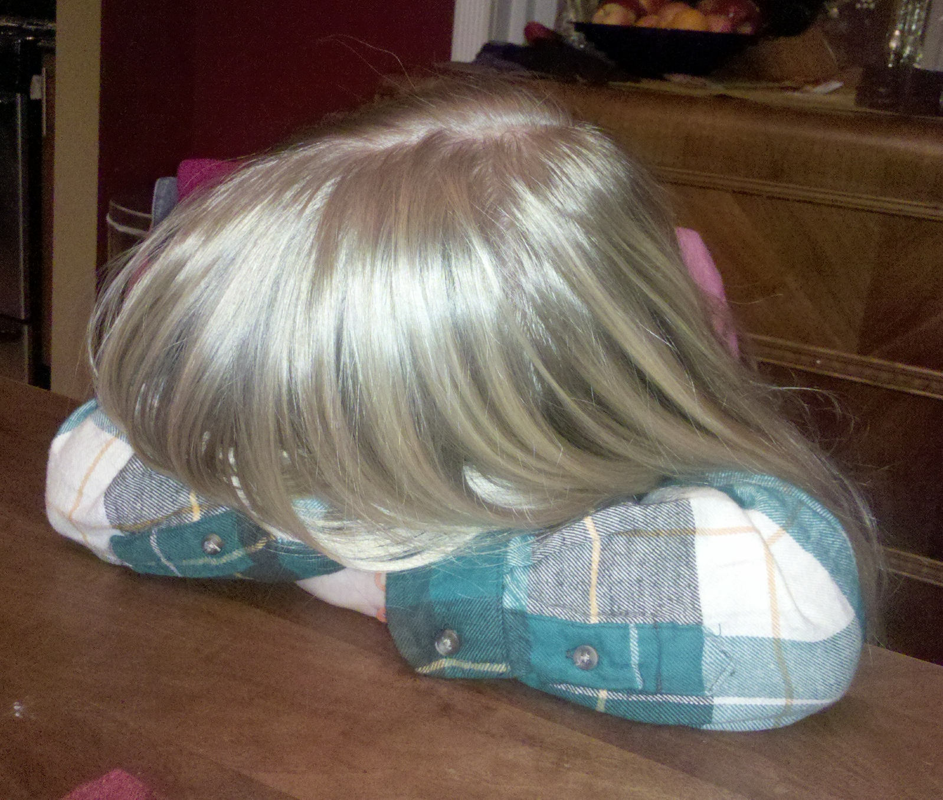
ACTION VERBS
ACTION VERB GIVES YOUR SUBJECT SOMETHING TO DO
Maria the girl in 4th hour with braces.
Maria is the subject but she is stalled,
she’s not doing anything.
Maria drops mad beats in 4th hour.
Give her an action verb and put her in motion

Slide 3
VERB PHRASE
Includes main verb plus any helping verbs also called auxiliary verbs.
Remember Maria and her mad beats….
Maria drops mad beats in 4th hour.
If you add a helping verb you get a verb phrase.
Maria might drop mad beats in 4th hour.

Slide 4
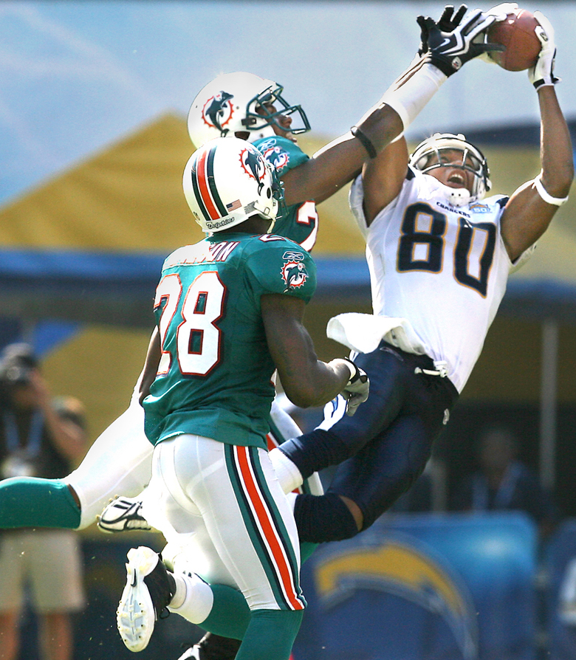
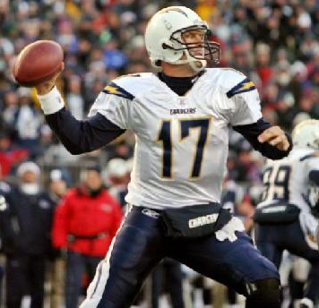
TRANSITIVE VERBS
A transitive verbs is
an action verb or verb phrase
that passes the action
from a doer to a receiver.

Slide 5
TRANSITIVE VERBS
Linking verbs wont be transitive or intransitive verbs. So stop thinking about them☺

Slide 6
Here’s an example
The quarter back threw the football.
The action verb is ___________
It passes it’s action to What or Whom? _______________
So it’s transitive
Using What or Whom is the key

Slide 7
TRY THESE
Spiders have transparent blood.
What’s the verb ______________ ( what or who) ______________
It’s transitive
I usually answer the phone on the second ring.
What’s the verb ______________ ( what or who) ______________
I mow the lawn on weekends.
What’s the verb ______________ ( what or who) ______________

Slide 8
TRANSITIVE or INTRASITIVE
Did you read this book for Mrs. Stanczyk’s class?
The robot will always answer politely.
The fire engine rushed through the red light.
Will you speak to that horse?
Will you speak Danish to the fox?
The fox said, “Yup- da –dup- da yup-da-dup!”

