Slide 1
COUSINO EDITION
9TH GRADE SURVIVAL
GUIDE

Slide 2
DO YOU FEEL LIKE THIS?
THIS SHOULD HELP

Slide 3
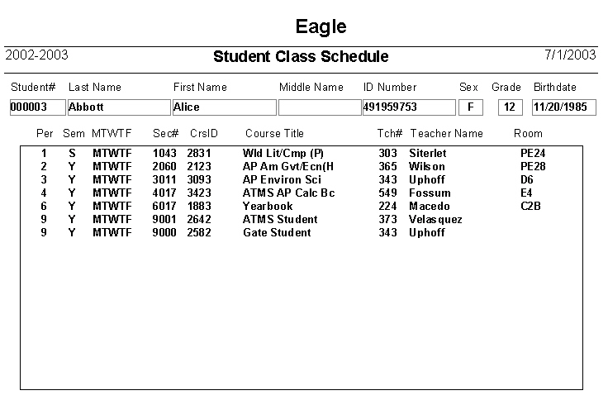
At the end of the hour
Take a pic
of your schedule

Slide 4
GETTING FROM
POINT A
TO
POINT B

Slide 5
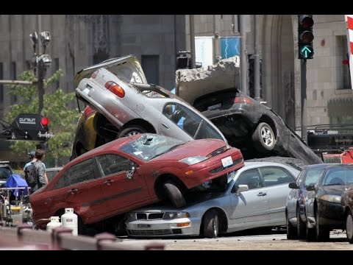
OBEY THE TRAFFIC LAWS
P
A
S
S
ON
T
H
E
L
E
F
T
S
T
A
Y
T
O
T
H
E
R
I
GH
T
DO NOT STOP IN TRAFFIC

Slide 6
apologize

Slide 7
Don’t text and walk

Slide 8
THERE ARE NO
ELEVATORS, ESCALATORS, OR ESCAPE HATCHES.
THERE IS NO NORTH HOUSE but
THERE SHOULD BE
THERE ARE 3 HOUSES:
EAST
SOUTH
&
WEST

Slide 9
IF YOU ARE LOST ASK FOR HELP.

Slide 10
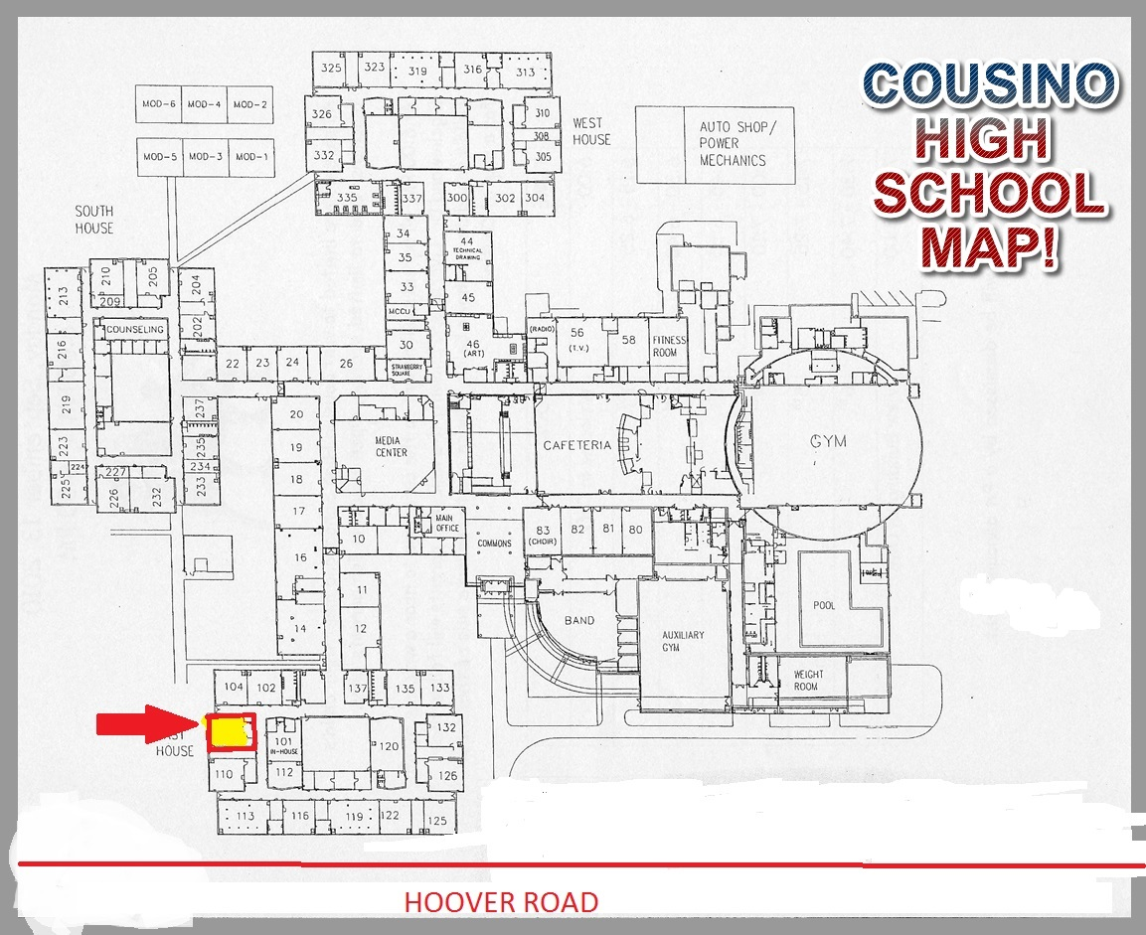
GIRLS BATHROOM
BOYS BATHROOM
EVERY HOUSE IS THE SAME SQUARE
HOUSE OFFICES

Slide 11
Cousino has 3 houses,
East,
South,
and
West

Slide 12
EAST HOUSE
LOST BOOKS
EAGLE
100’S

Slide 13
EAST HOUSE
ACADEMICS
MRS. PIROG

Slide 14
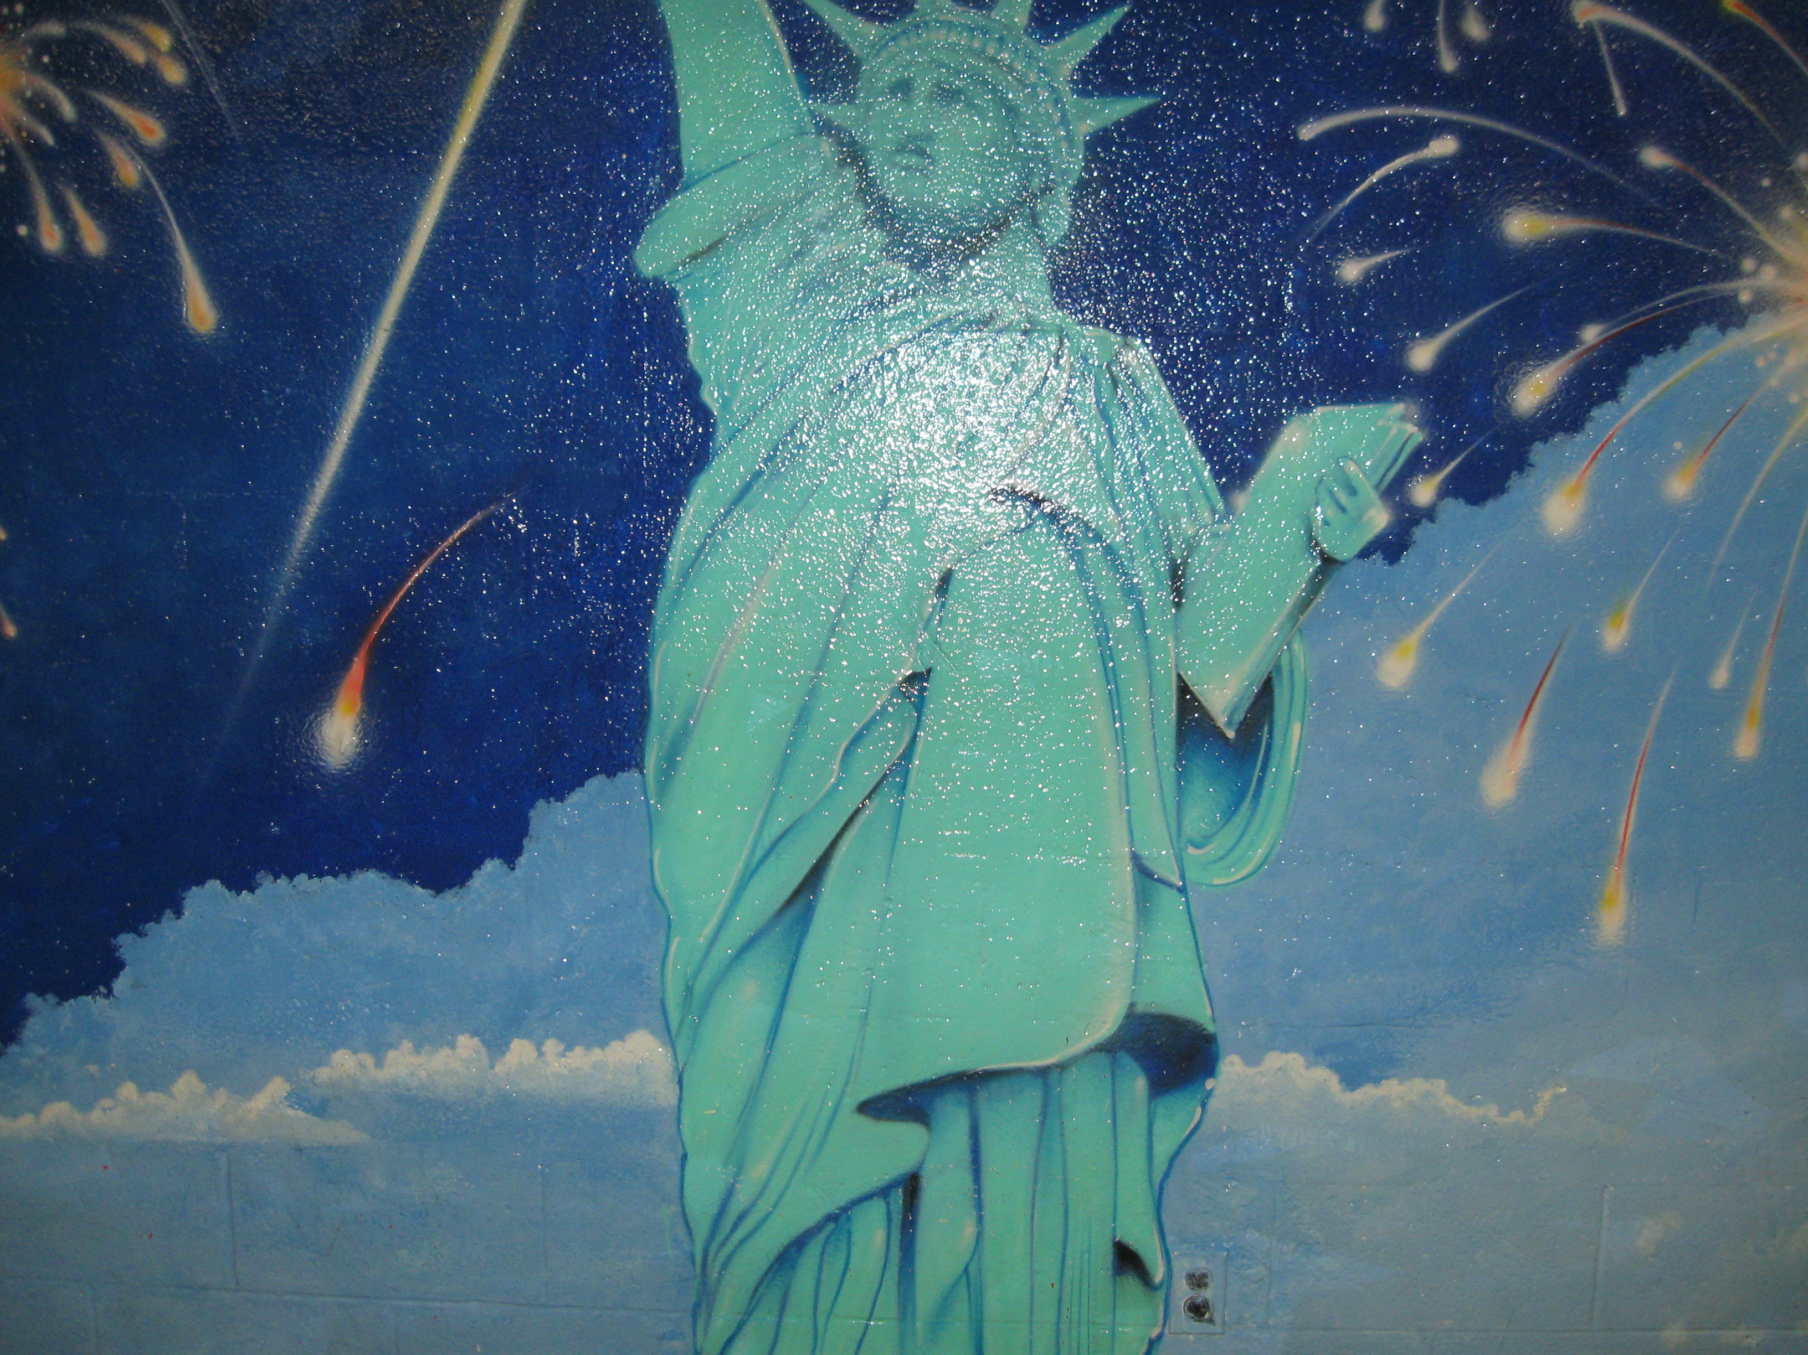
SOUTH HOUSE
COUNSELING OFFICE (schedules and stuff)
STATUE OF LIBERTY
200’S

Slide 15
SOUTH HOUSE
MR. CWAYNA
ATTENDANCE

Slide 16
WEST HOUSE
WARRIOR
300’S

Slide 17
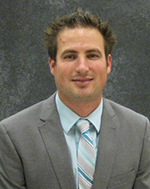
WEST HOUSE
DISCIPLINE
MR.
SHEPPARD
Notes:
End day 2

Slide 18
LUNCH
GET THERE QUICKLY
NO BAGS IN LINE
EVERYTHING IS ON CAMERA

Slide 19
IN THE CLASSROOM
LOOK AT THE LEARNING TARGET
CHECK IN FIRST
THEN GO TO BATHROOM OR LOCKER
TALK TO YOUR TEACHER
BEFORE OR AFTER CLASS
START YOUR BELL WORK

Slide 20
GRADES
CHECK PARENT PORTAL DAILY- MAKE IT YOUR HOME PAGE
TALK TO YOUR TEACHERS:
ABOUT MISSING ASSIGNMENTS
QUESTIONS YOU HAVE
KEEP ALL YOUR WORK
TAKE NOTES
DO YOUR HOMEWORK!

Slide 21
There is NO Freshman Friday

