Slide 1
Assume whoever is reading your essay has NOT read the story or novel.

Slide 2
Don’t say:
The necklace is an example of her greed?
What necklace! I haven’t read the story!
When her husband doesn’t get the gun she should be grateful.
Why doesn’t he get his gun?

Slide 3
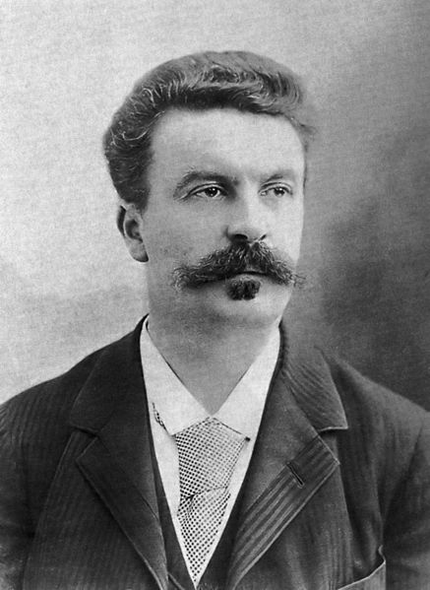
Always state the name of the book or story and the author’s name the first time you mention it.

Slide 4
The theme of The Necklace by Guy De Maupassant is….
In Guy De Maupassant’s The Necklace the theme is….

Slide 5
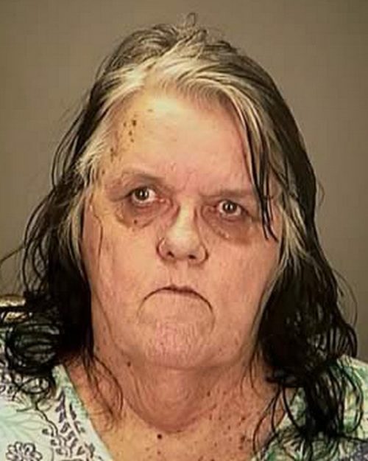
Include a basic plot summary
In the story a young woman yearns for her college days where her life was carefree. Through a series of events she winds up in jail facing her darkest demons.

Slide 6
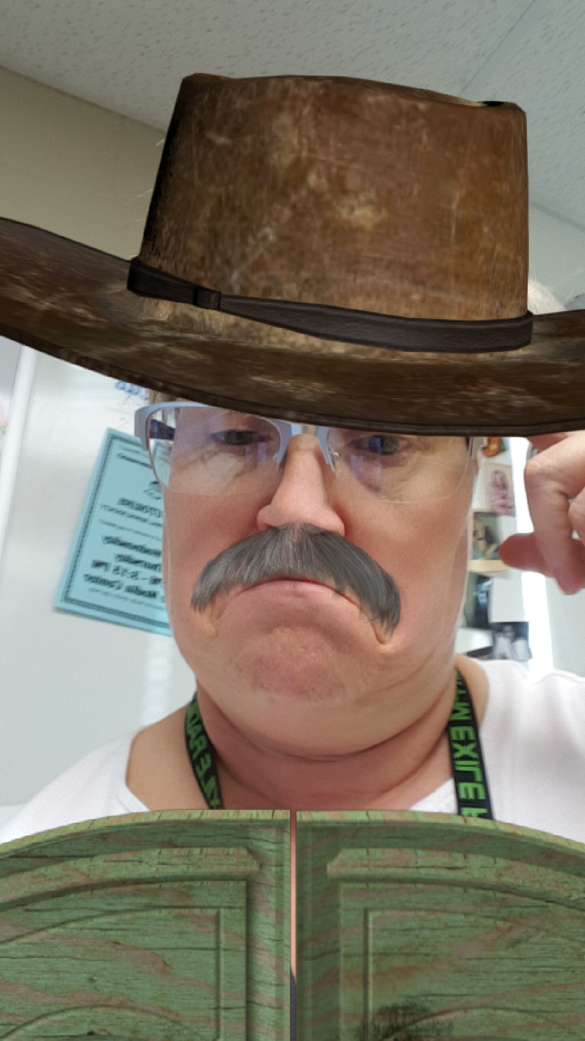
Name the characters

Slide 7
The main character Mathilde is self centered and distant.
Mathilde, the main character, is self centered and distant.
Mathilde’s husband, Monsieur Loisel, is generous and loving.
Mathilde’s wealthy friend, Madame Forestier, is also generous and seemingly loving.

Slide 8
Do not use “I” statements

Slide 9
I think the theme of The Necklace by Guy De Maupassant is..
I believe the theme of The Necklace by Guy De Maupassant is..

Slide 10
Do not start sentences with:
Because
And
But
Or

